Slide 1

IFCPC 2011 Nomenclature:
How to use this to grade and report your colposcopic findings
James Bentley
Secretary General IFCPC
Professor Department of Obstetrics and Gynaecology
Dalhousie University, Halifax, Canada

Slide 2
Disclosure
Dr. Bentley has given lectures for GSK and Merck
Dr. Bentley is not an employee of, nor involved in, any investment in GSK or Merck
Dr Bentley has done research funded by GSK, Merck and Guided Therapeutics

Slide 3
International Federation of National Colposcopic Societies
41 society members
$5 per member per year from society membership fee
The Federation intends to:
  A. Stimulate basic and applied research and the diffusion of knowledge in matters related to cervical pathology and colposcopy;
  B. Stimulate the creation of national societies;
  C. Contribute to the standardization of terminology and evaluation of diagnostic and therapeutic procedures in the field of cervical pathology and colposcopy;
  D. Hold World Congresses at regular intervals, each held successively in a different country;
  E. Take part in and, where possible, sponsor regional or national congresses organized by affiliated societies;
  F. Where possible, help co-ordinate the dates of conferences which are relevant to the field of cervical pathology and colposcopy;
  G. Collaborate with affiliated societies whenever joint scientific action is appropriate; and,
  H. Nurture international and regional collaborative efforts related to training or research in cervical pathology and colposcopy.

Slide 4
Colposcopic Variation
Routine part of Gyn exam in parts of Europe
Only after an abnormal screening test- UK, USA, Canada, Australia etc.
“cold knife cone biopsy” often done without any colposcopy assessment in parts of France and Germany
Conisation vs. cone vs. LEEP vs LLETZ

Slide 5
Colposcopic Practice
Evolving to treatment of higher end of precancerous spectrum
Monitoring of low grade vs. discharge
Treatment with LEEP
Need to accurately differentiate between HSIL and LSIL (histology)

Slide 6
2003
Bornstein J et al. Obstet Gynecol 2012;166-72
Walker P et al. Obstet Gynecol 2003; 101: 175-177
Rational:
Compare practice
Standardize terminology (e.g. cone biopsy)
Height vs. depth of LEEP
Committee looked at evidence for all findings

Slide 7
2011 IFCPC Terminology accepted Rio July 2011
General assessment | Adequate/inadequate for the reason … (i.e. cervix obscured by inflamation, bleeding, scar)
 | Squamo-columnar junction visibility: completely visible, partially visible, not visible
 | Transformation zone types 1,2,3
Normal Colposcopic findings | Original squamous epithelium:
 | Mature
 | Atrophic
 | Columnar epithelium
 | Ectopy
 | Metaplastic squamous epithelium
 | Nabothian cysts
 | Crypt (gland) openings
 | Deciduosis in pregnancy
Bornstein J et al. Obstet Gynecol 2012;120:166-72
http://www.ifcpc.org/documents/nomenclature7-11.pdf

Slide 8
2011 IFCPC Terminology accepted Rio July 2011
Abnormal colposcopic findings | General Principles | Location of the lesion: inside or outside the T-zone, location of the lesion by clock position
 |  | Size of the Lesion: Number of quadrants the lesion covers, Size of the lesion in percentage of cervix
 | Grade 1 (minor) | Thin aceto-white epithelium Irregular, geographic border | Fine mosaic Fine punctation
 | Grade 2 (major) | Dense aceto-white epithelium, Rapid appearance of acetowhitening, Cuffed crypt (gland) openings | Coarse mosaic, Coarse Punctation, Sharp border, Inner border sign, Ridge sign
 | Non specific | Leucoplakia (keratosis, hyperkeratosis), erosion Lugol’s staining (Shiller’s test) stained/non-stained
Bornstein J et al. Obstet Gynecol 2012;120:166-72
http://www.ifcpc.org/documents/nomenclature7-11.pdf

Slide 9
Transformation zone type

Slide 10
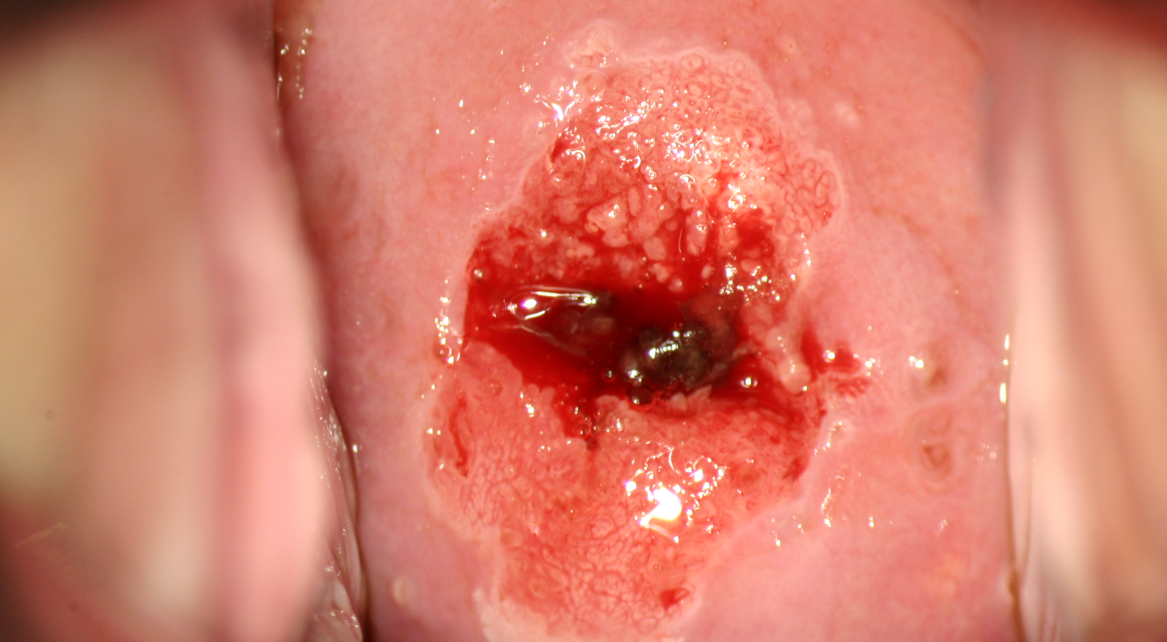
Transformation zone type 1

Slide 11
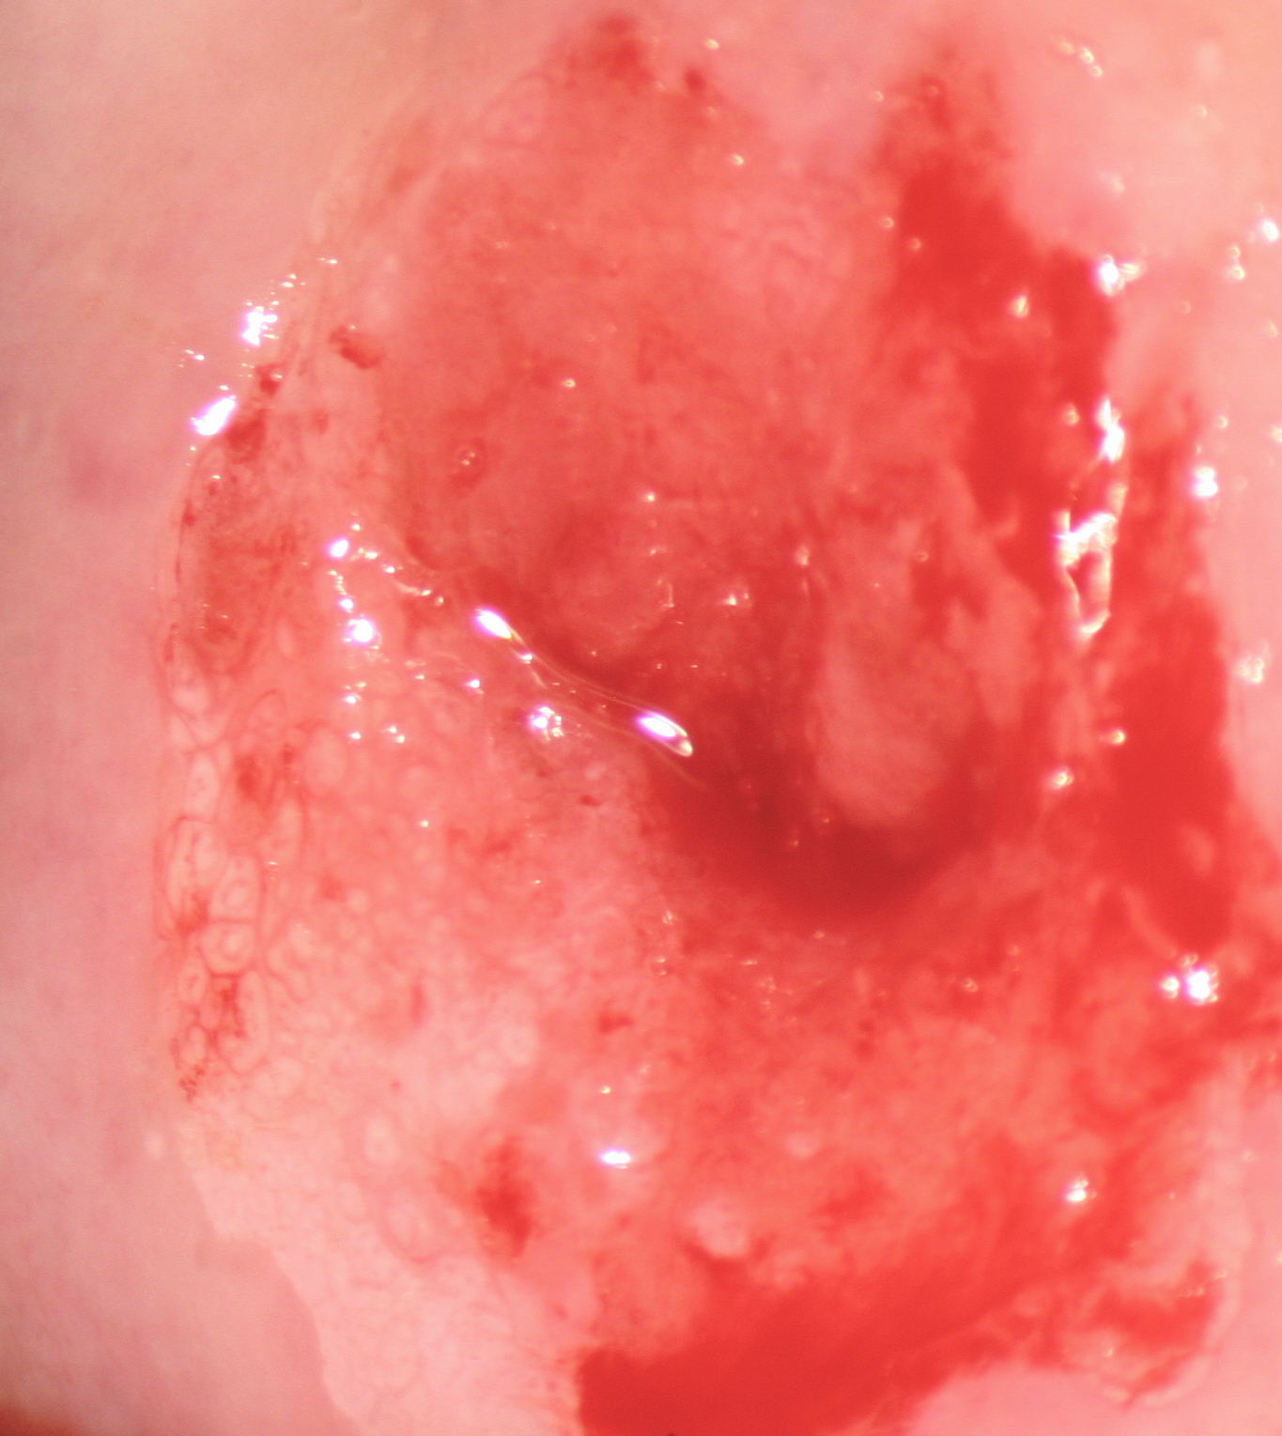
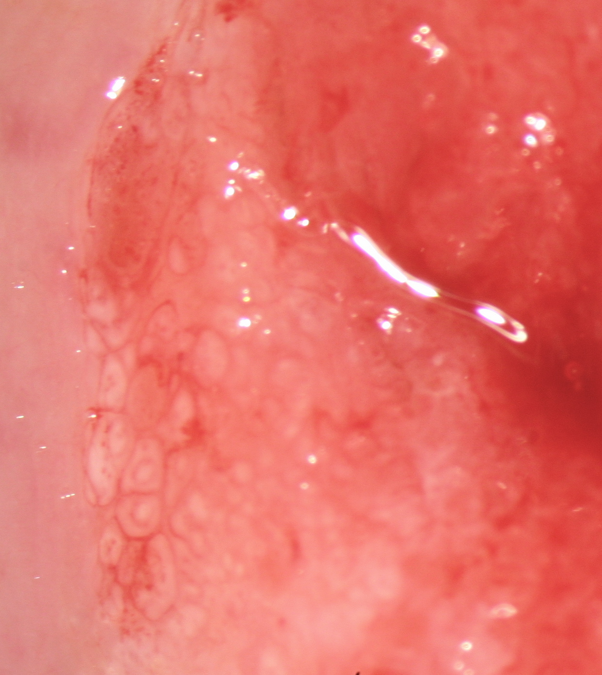
Transformation zone type 2

Slide 12
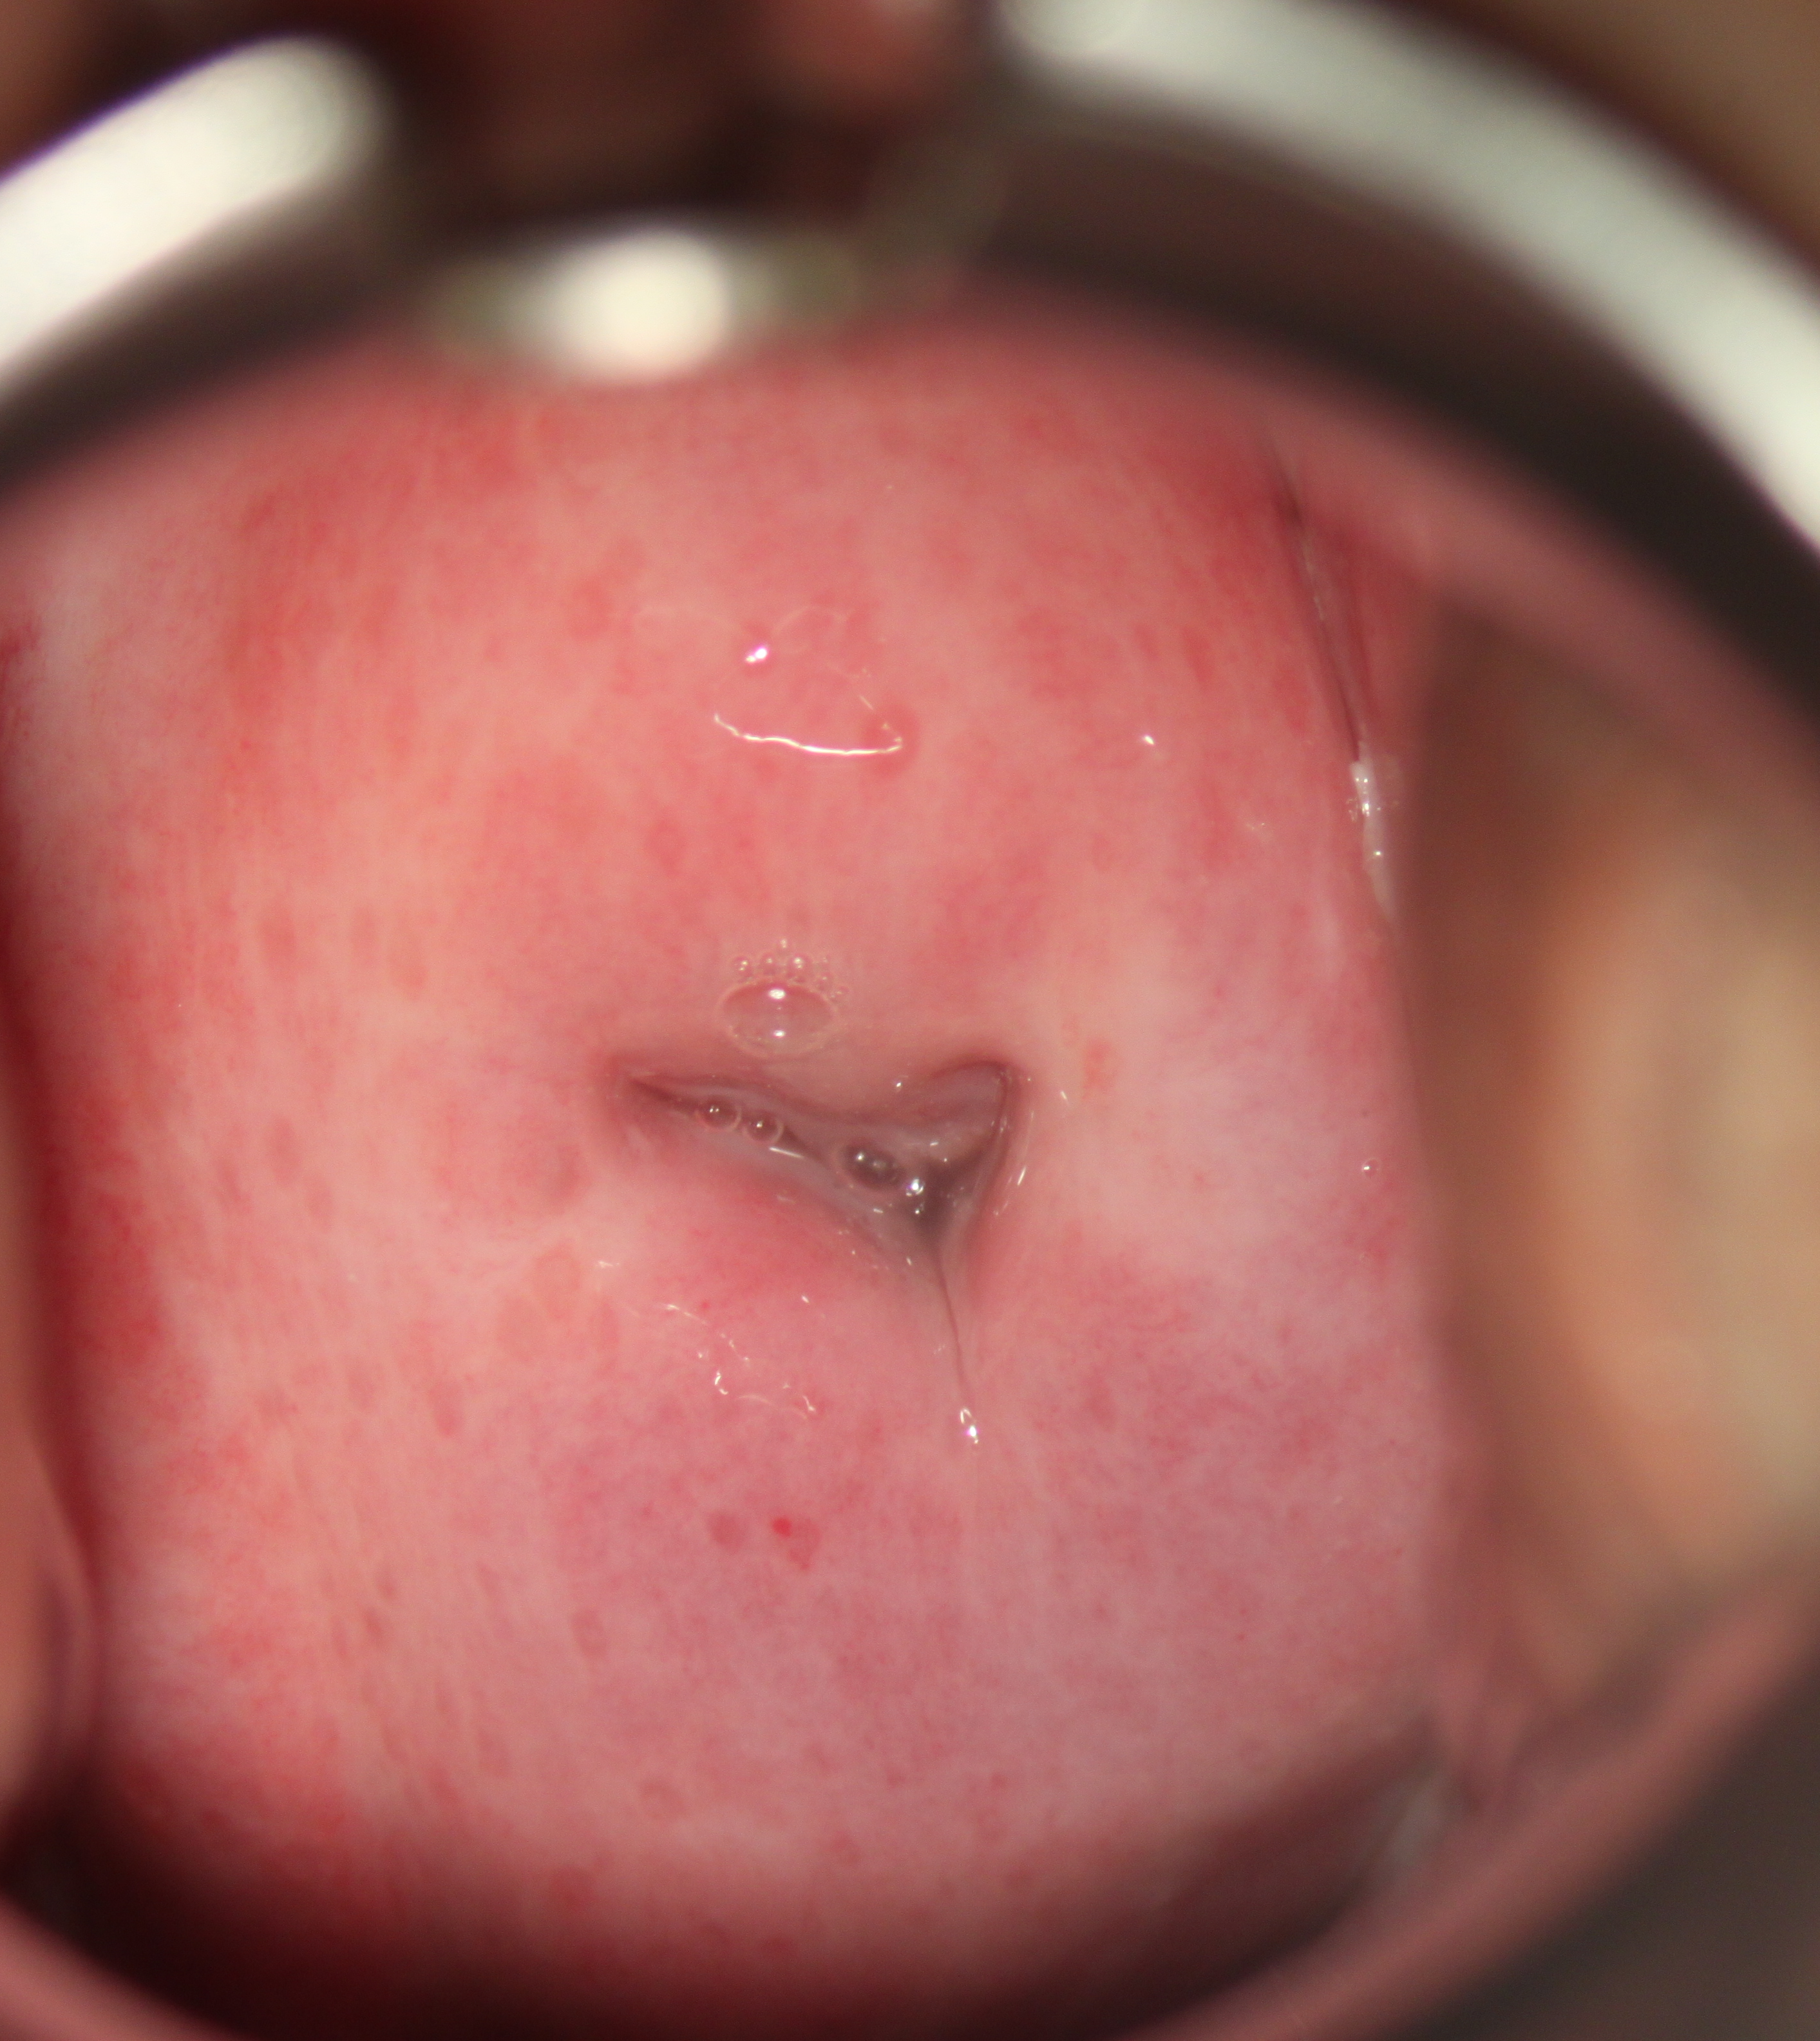
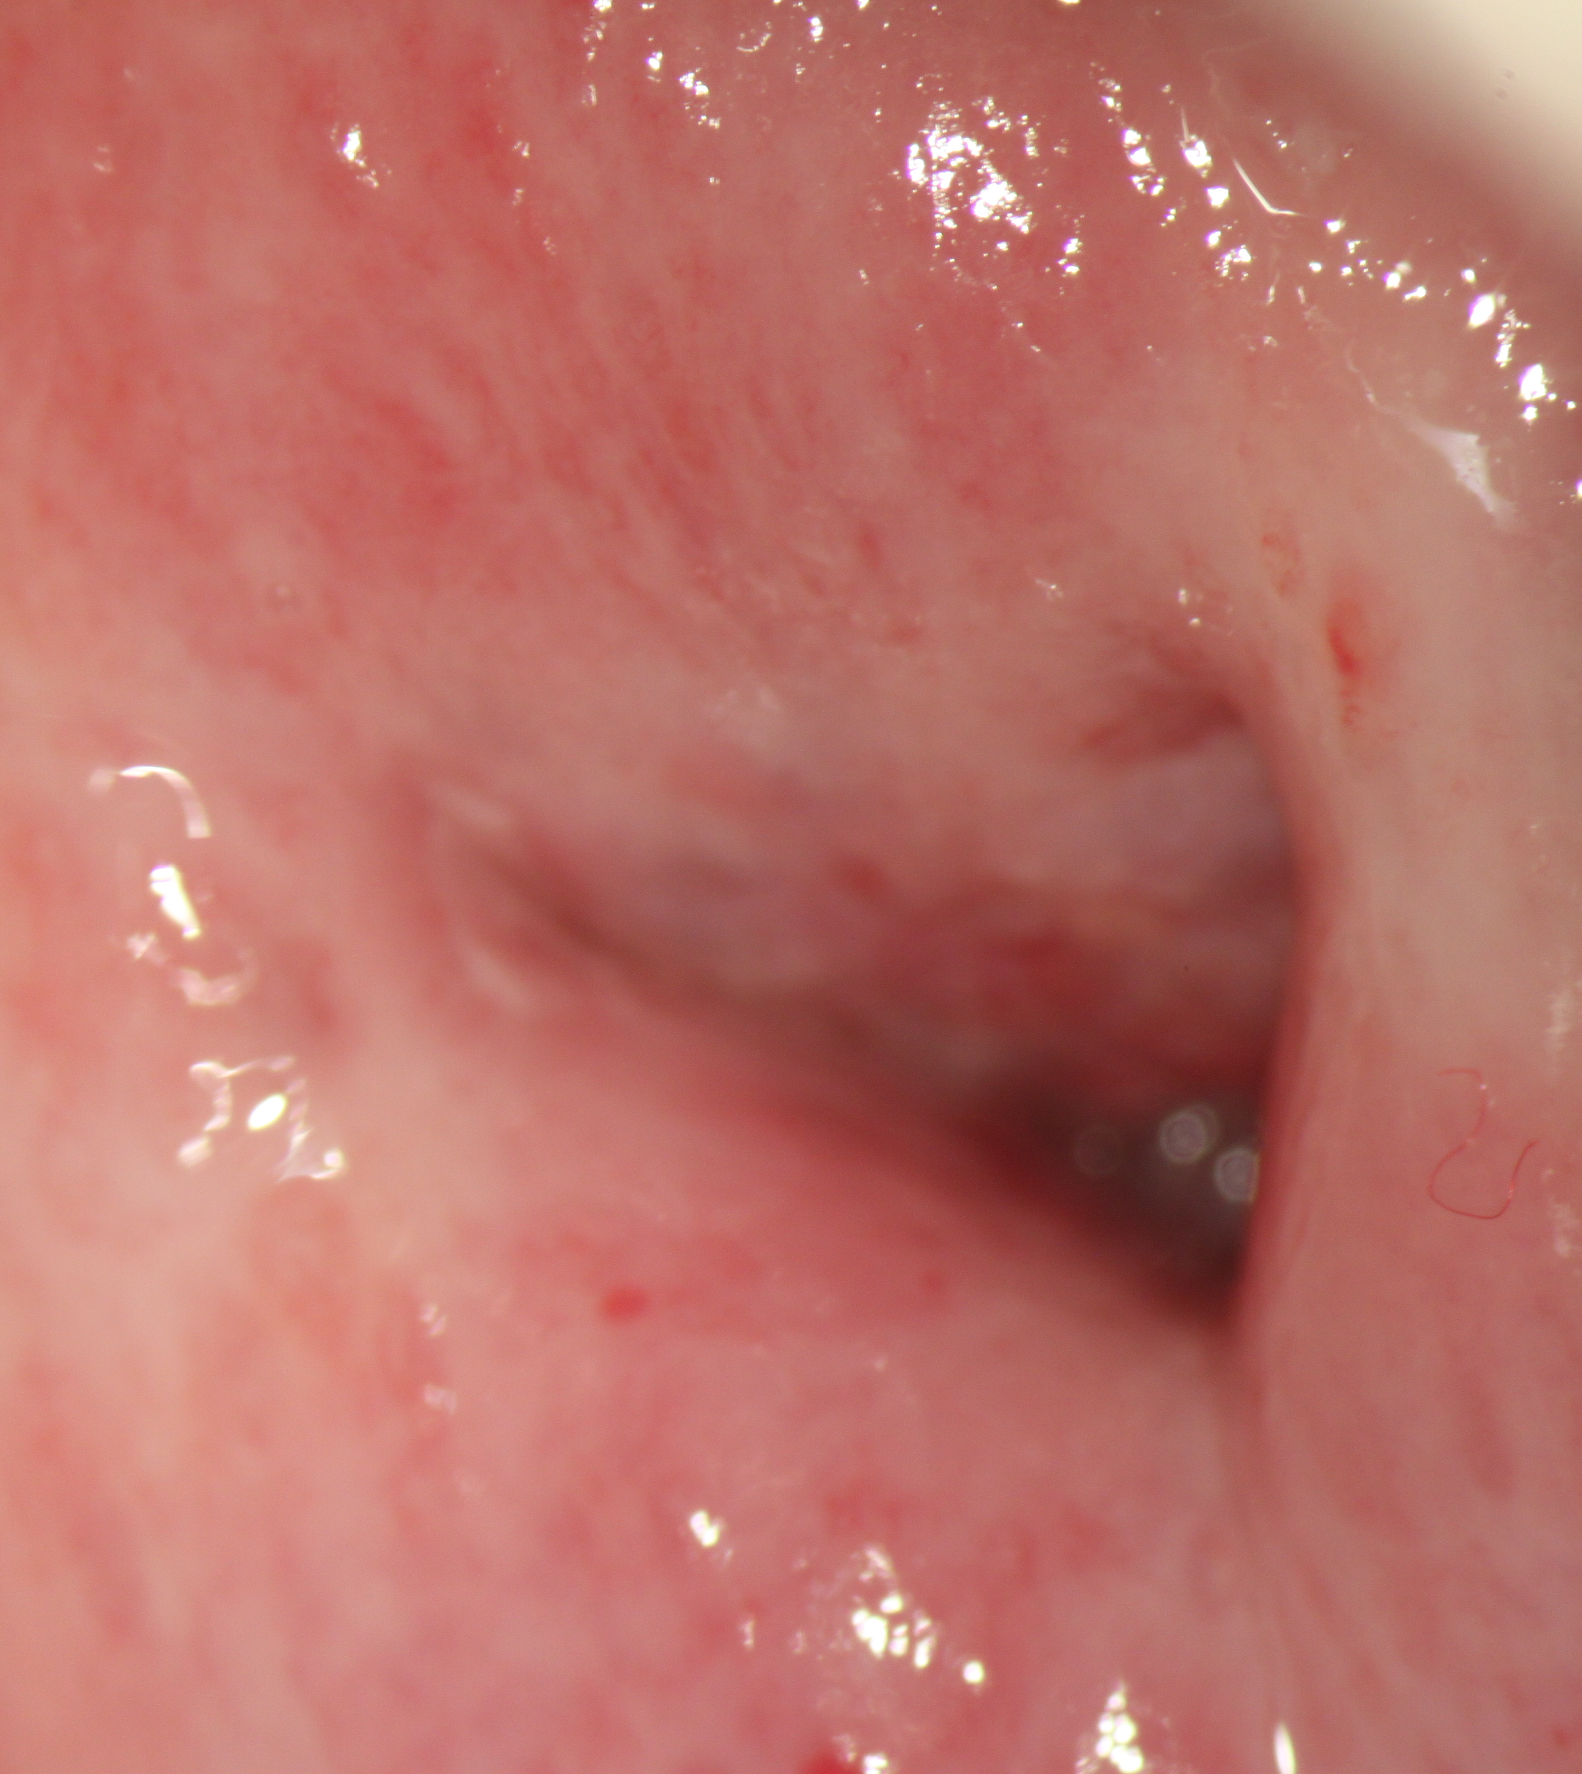
Transformation zone type 3

Slide 13

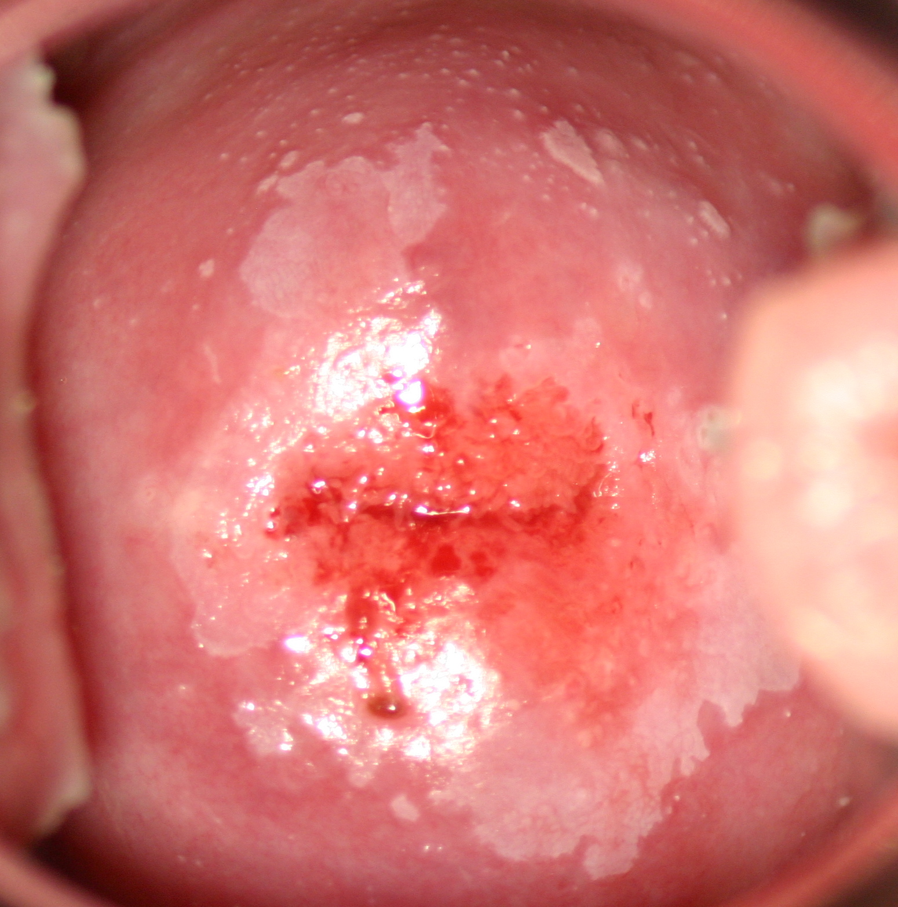
grade 1: fine acetowhite

Slide 14
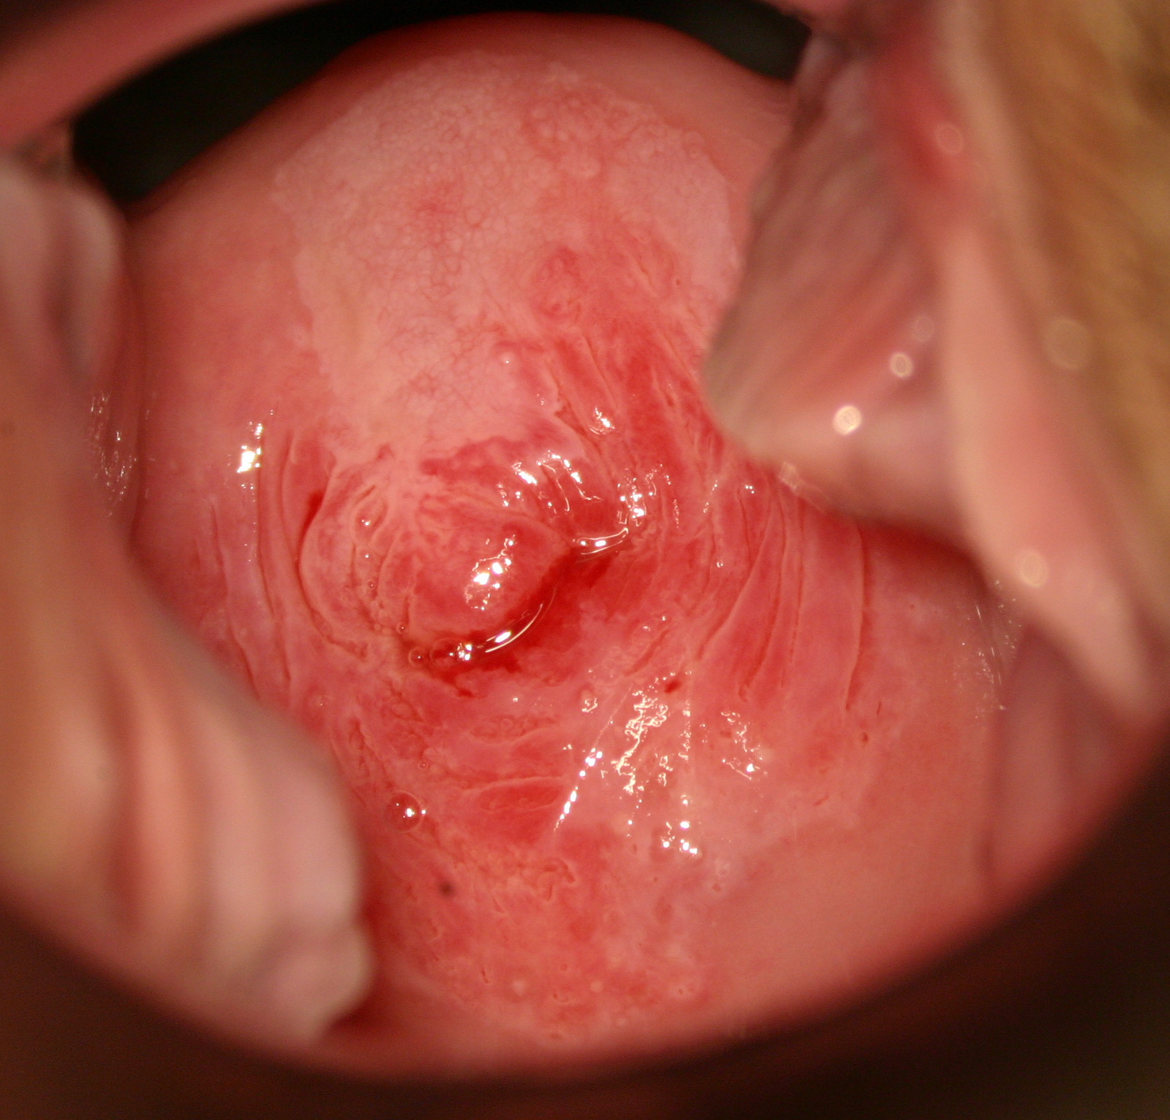
grade 1: fine mosaic

Slide 15
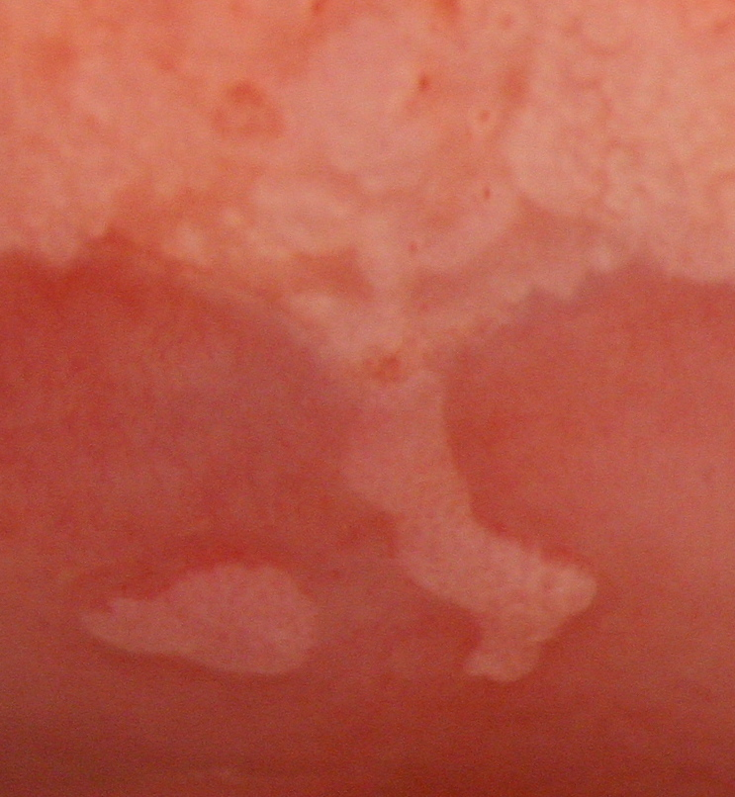
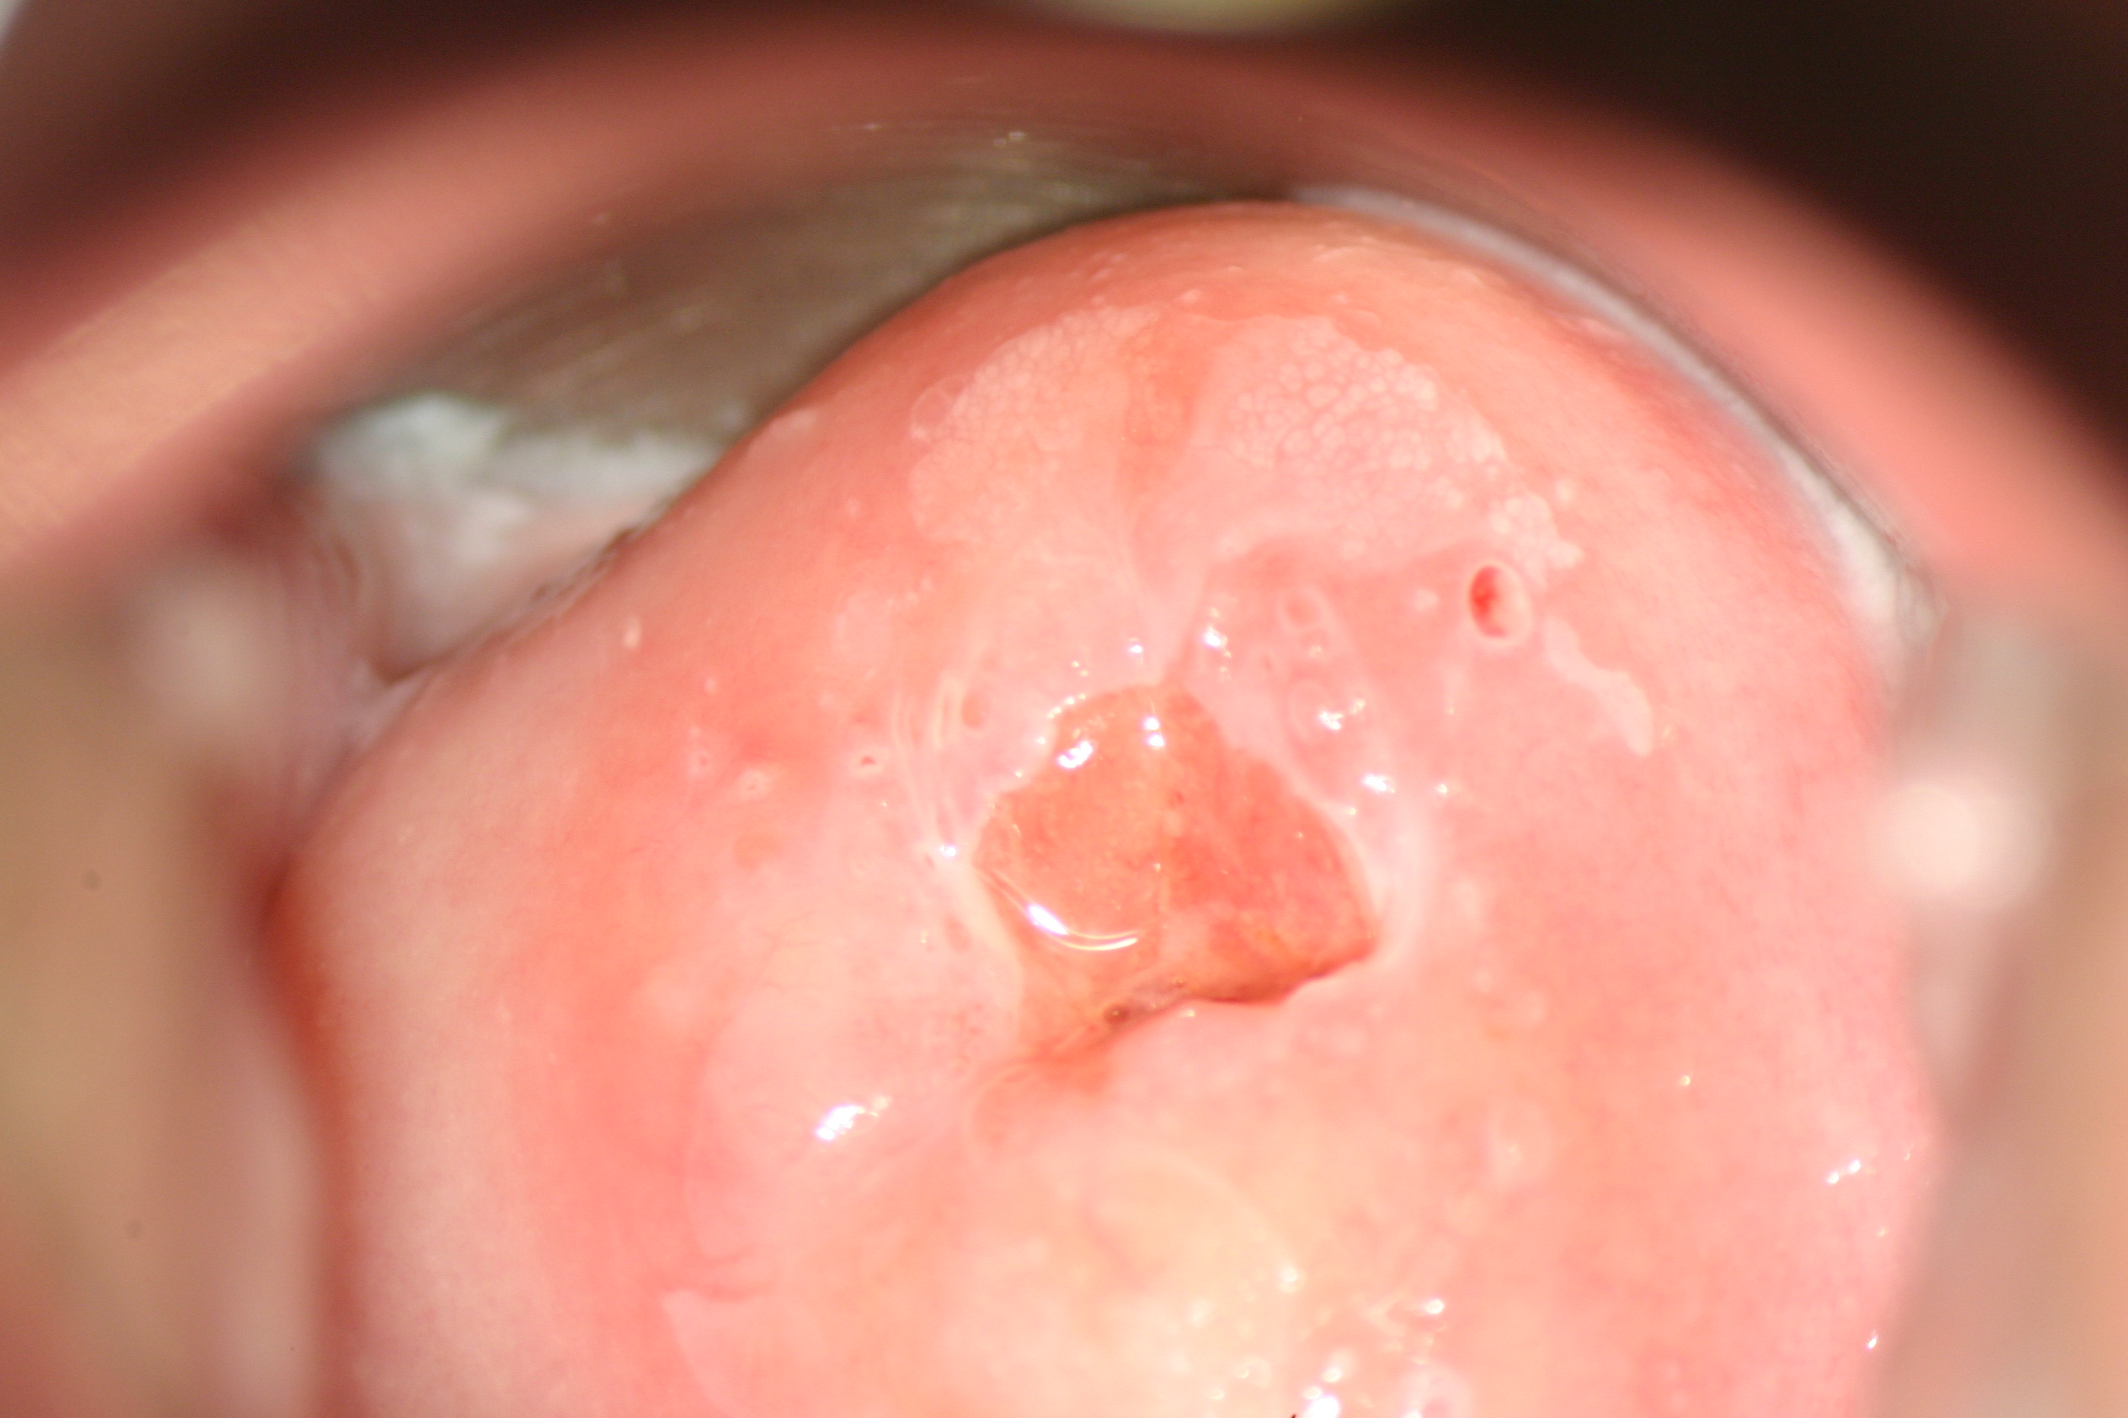
Grade 1 Colposcopic features (minor)
Thin aceto-white epithelium
Geographic margin
Fine mosaicism
Satellite lesions

Slide 16
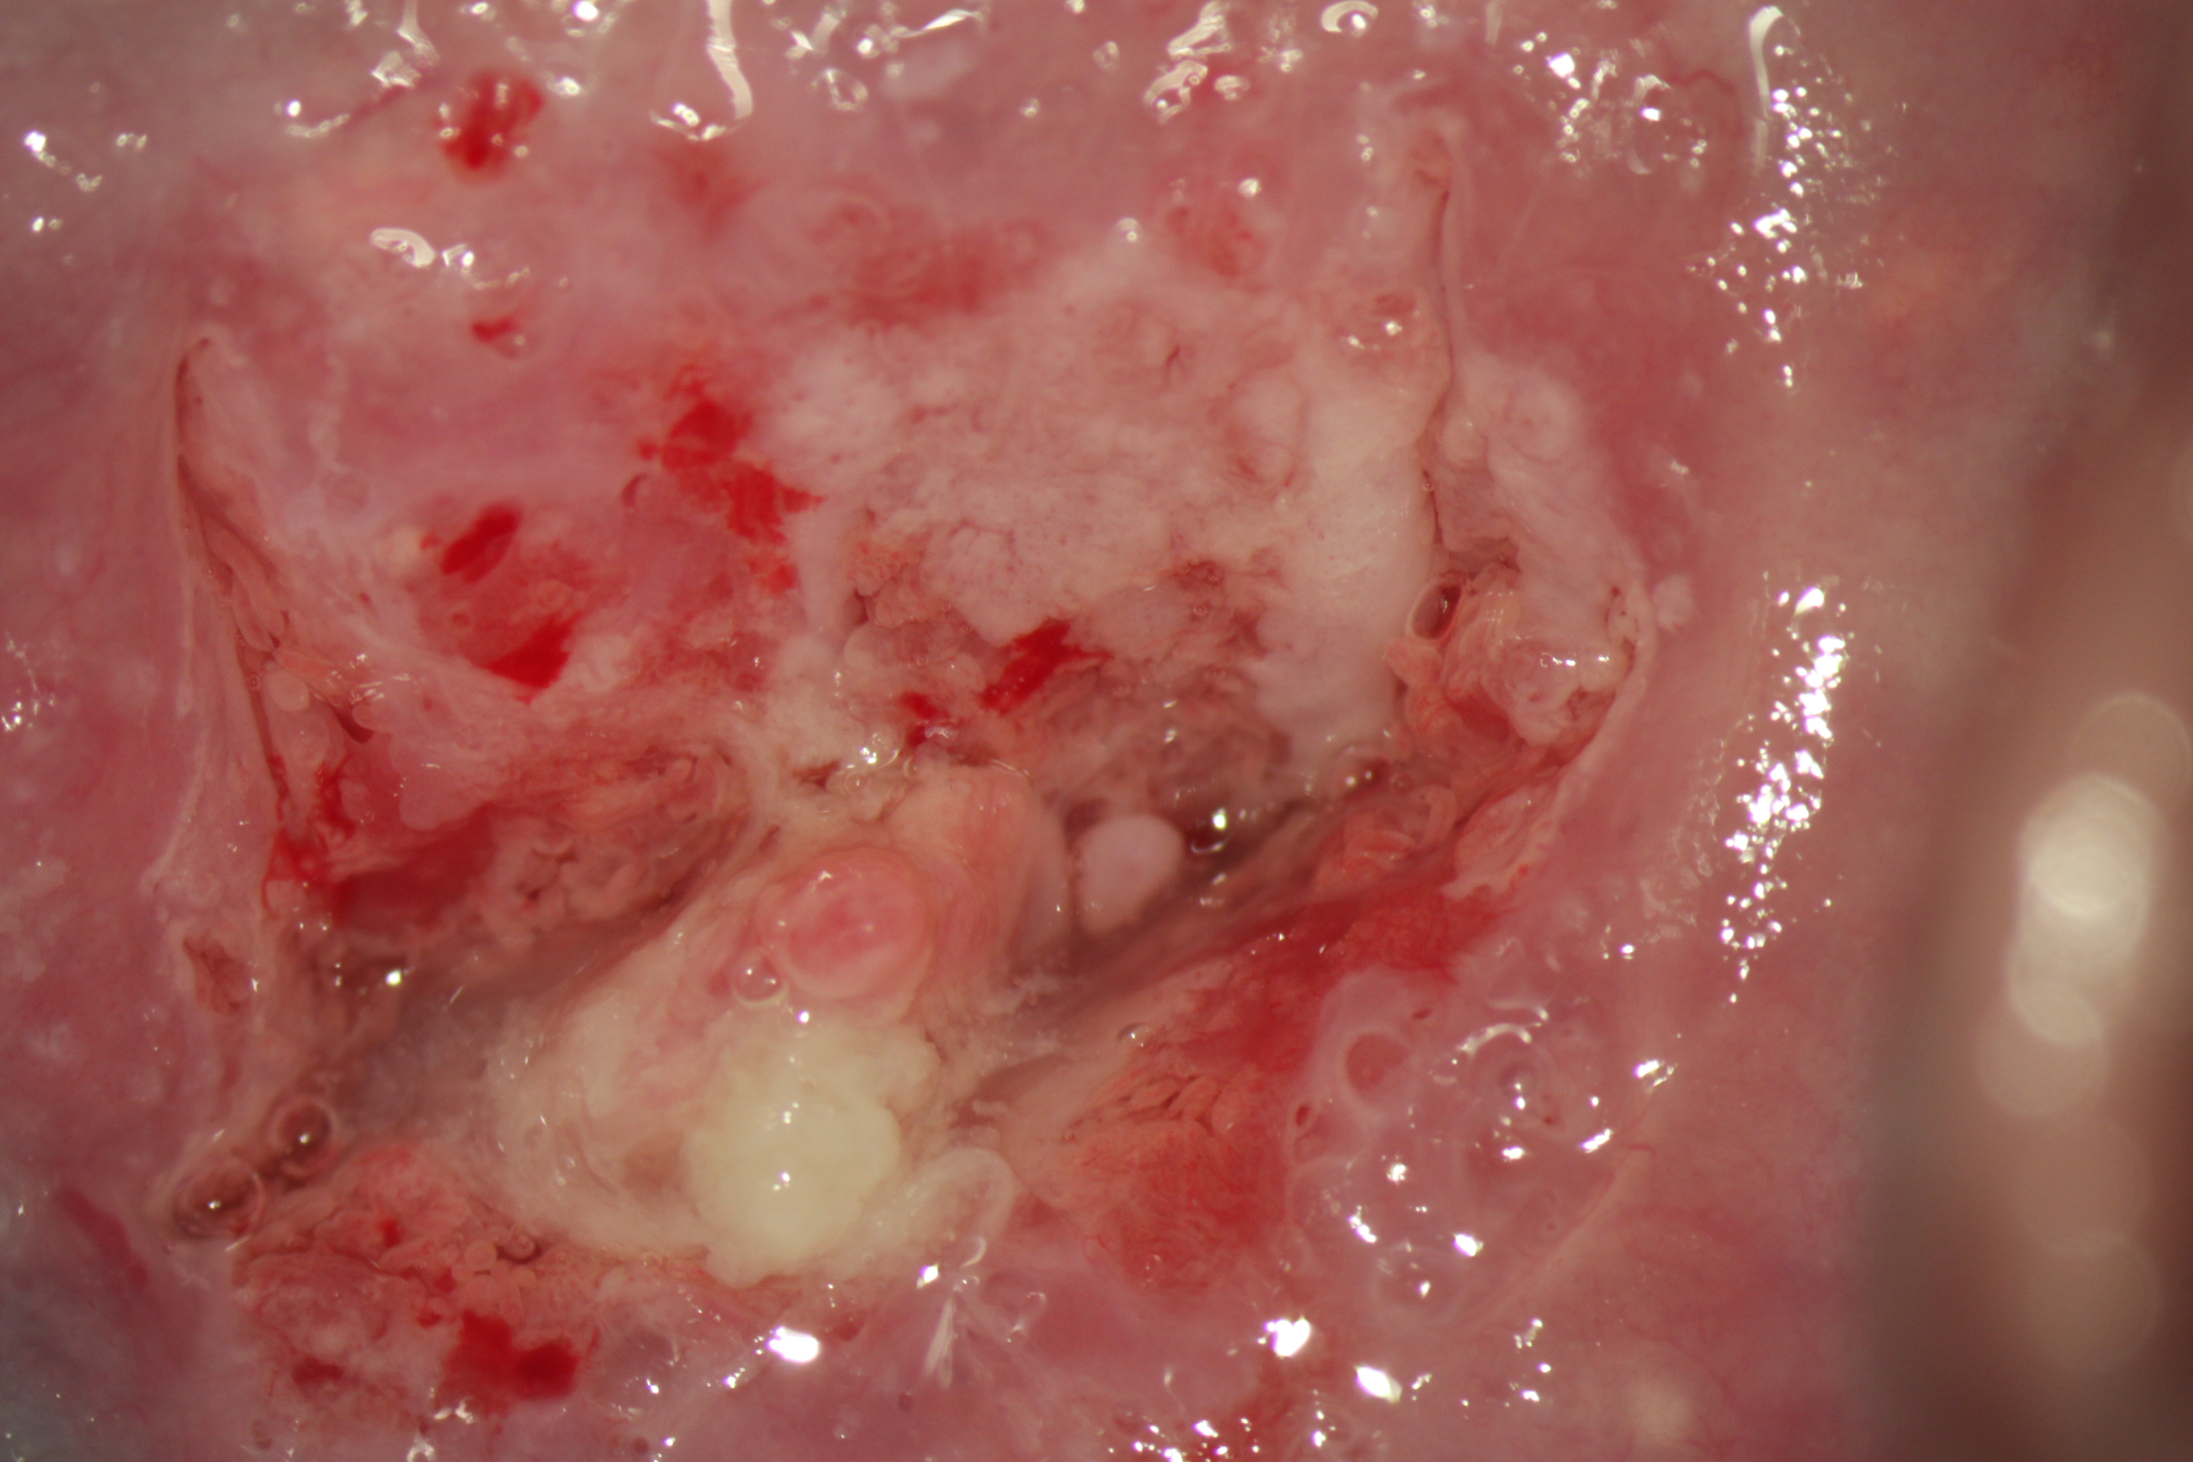
Grade 2: dense aceto-white

Slide 17
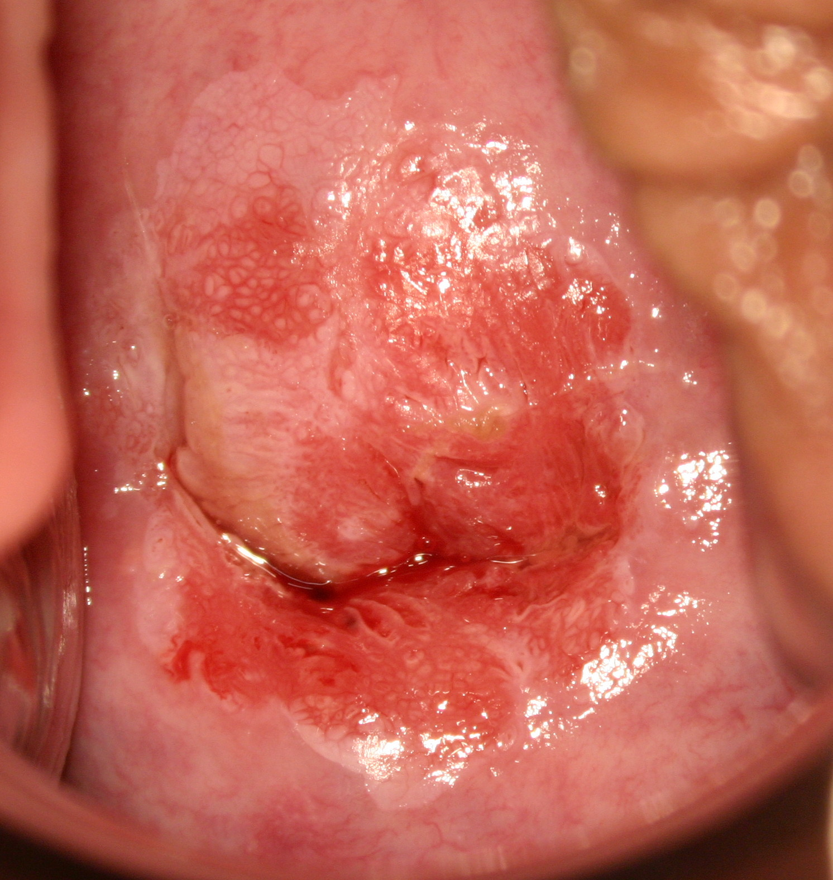
Grade 2: inner border sign

Slide 18
Grade 2 features: inner border sign

Slide 19
Grade 2 features: ridge sign

Slide 20
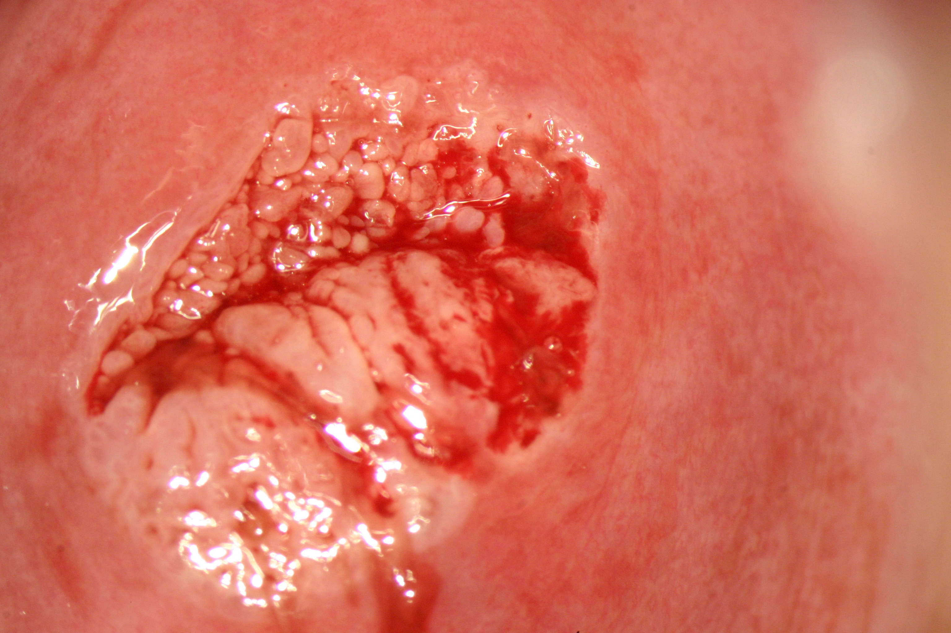
Grade 2 features: ridge sign

Slide 21
2011 IFCPC Terminology accepted Rio July 2011
Abnormal colposcopic findings | Suspicious for invasion | Atypical vessels Additional signs: Fragile vessels, Irregular surface, Exophytic lesion, Necrosis, Ulceration (necrotic), tumor/ gross neoplasm
 | Miscellaneous findings | Congenital T-zone Condyloma, Polyp (Ectocervical/ endocervical) Inflammation | Stenosis, Congenital anomaly, Post treatment consequence Endometriosis
Bornstein J et al. Obstet Gynecol 2012;120:166-72
http://www.ifcpc.org/documents/nomenclature7-11.pdf

Slide 22
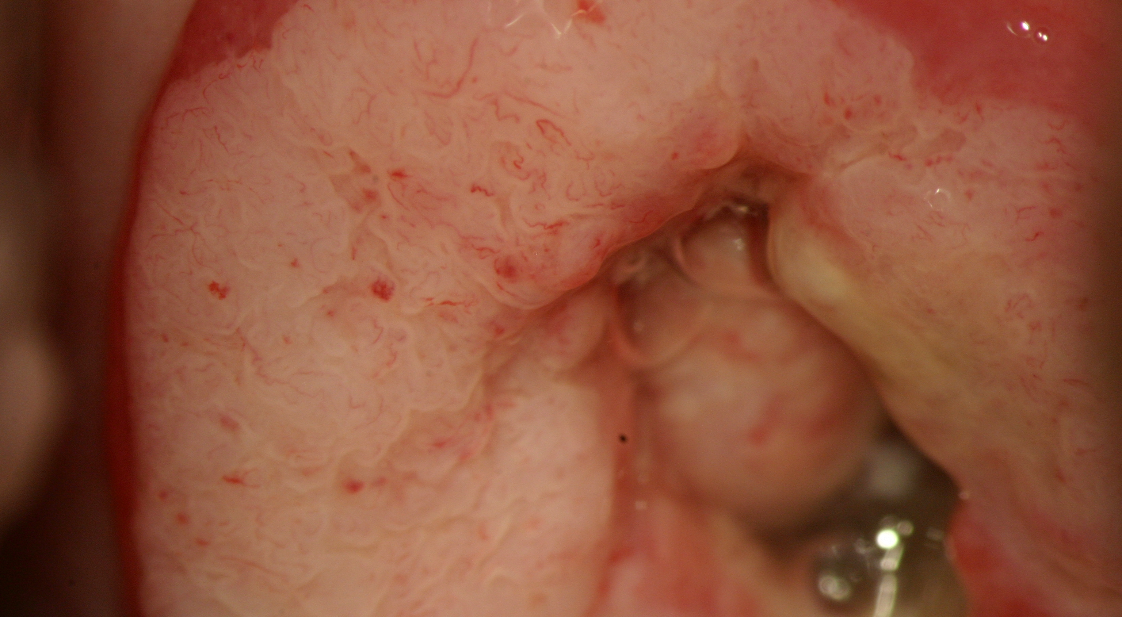
Suspicious for invasion

Slide 23
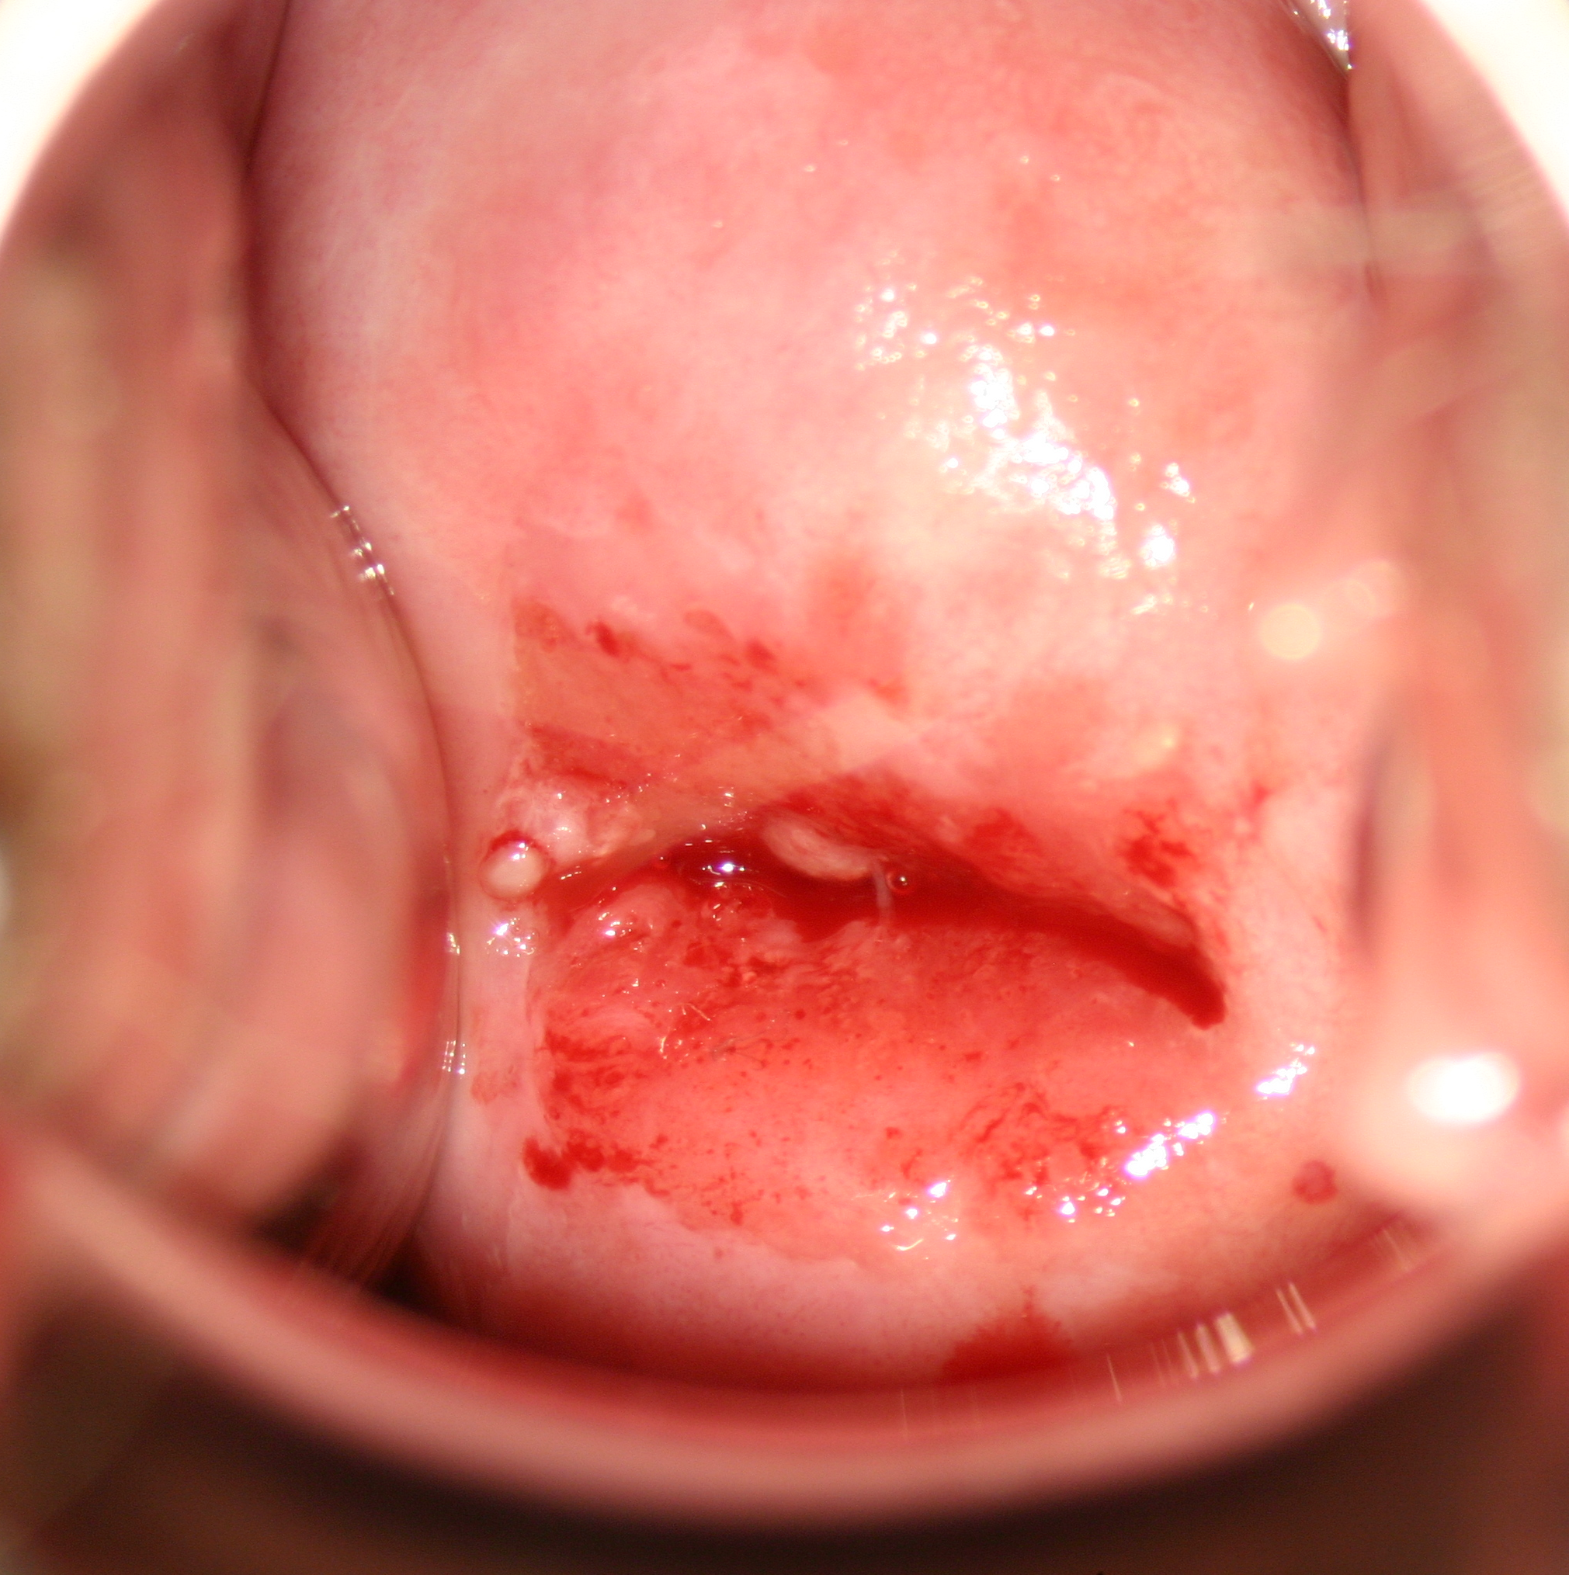
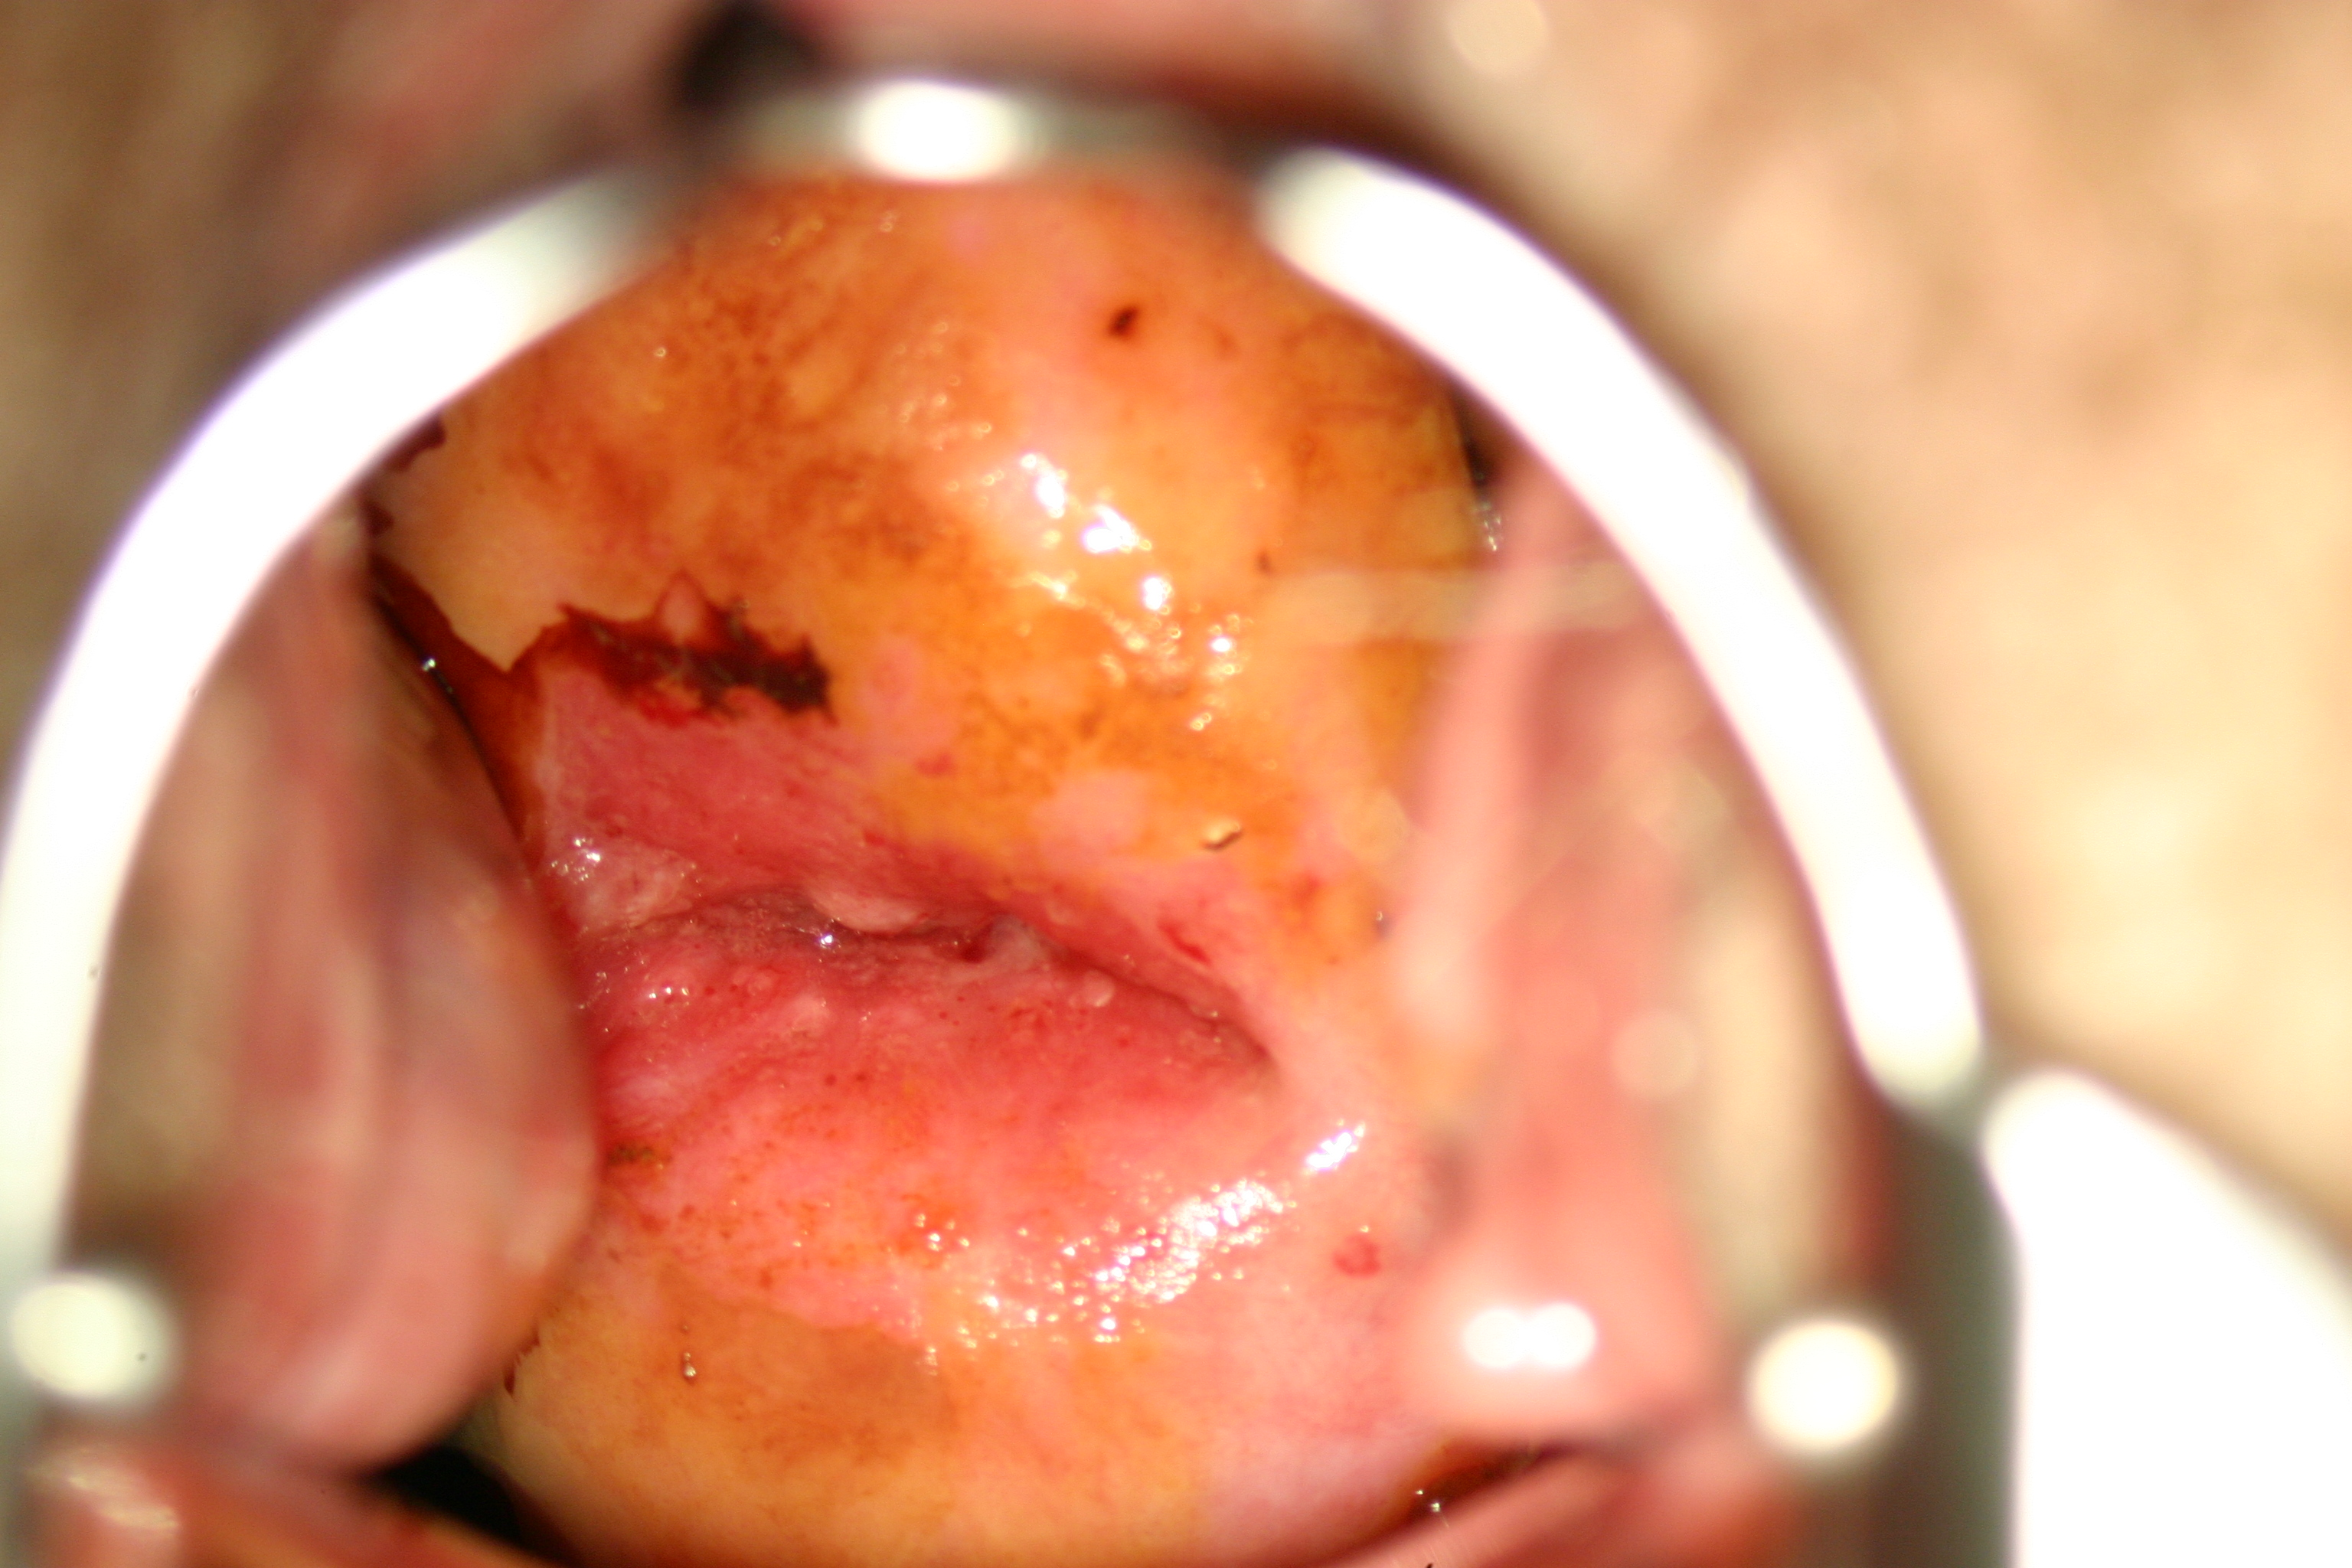
Congenital transformation zone

Slide 24
2011 IFCPC Terminology accepted Rio July 2011
Excision treatment types | Excision type 1,2,3
Excision specimen Dimensions | Length- the distance from the distal/external margin to the proximal/internal margin
 | Thickness- the distance from the stromal margin to the surface of the excised specimen
 | Circumference (optional)- the perimeter of the excised specimen
Bornstein J et al. Obstet Gynecol 2012;120:166-72
http://www.ifcpc.org/documents/nomenclature7-11.pdf

Slide 25
Excision Treatment type

Slide 26
2011 IFCPC Terminology accepted Rio July 2011
Bornstein J et al. Obs Gyn 2012 July
http://www.ifcpc.org/documents/nomenclature7-11.pdf

Slide 27
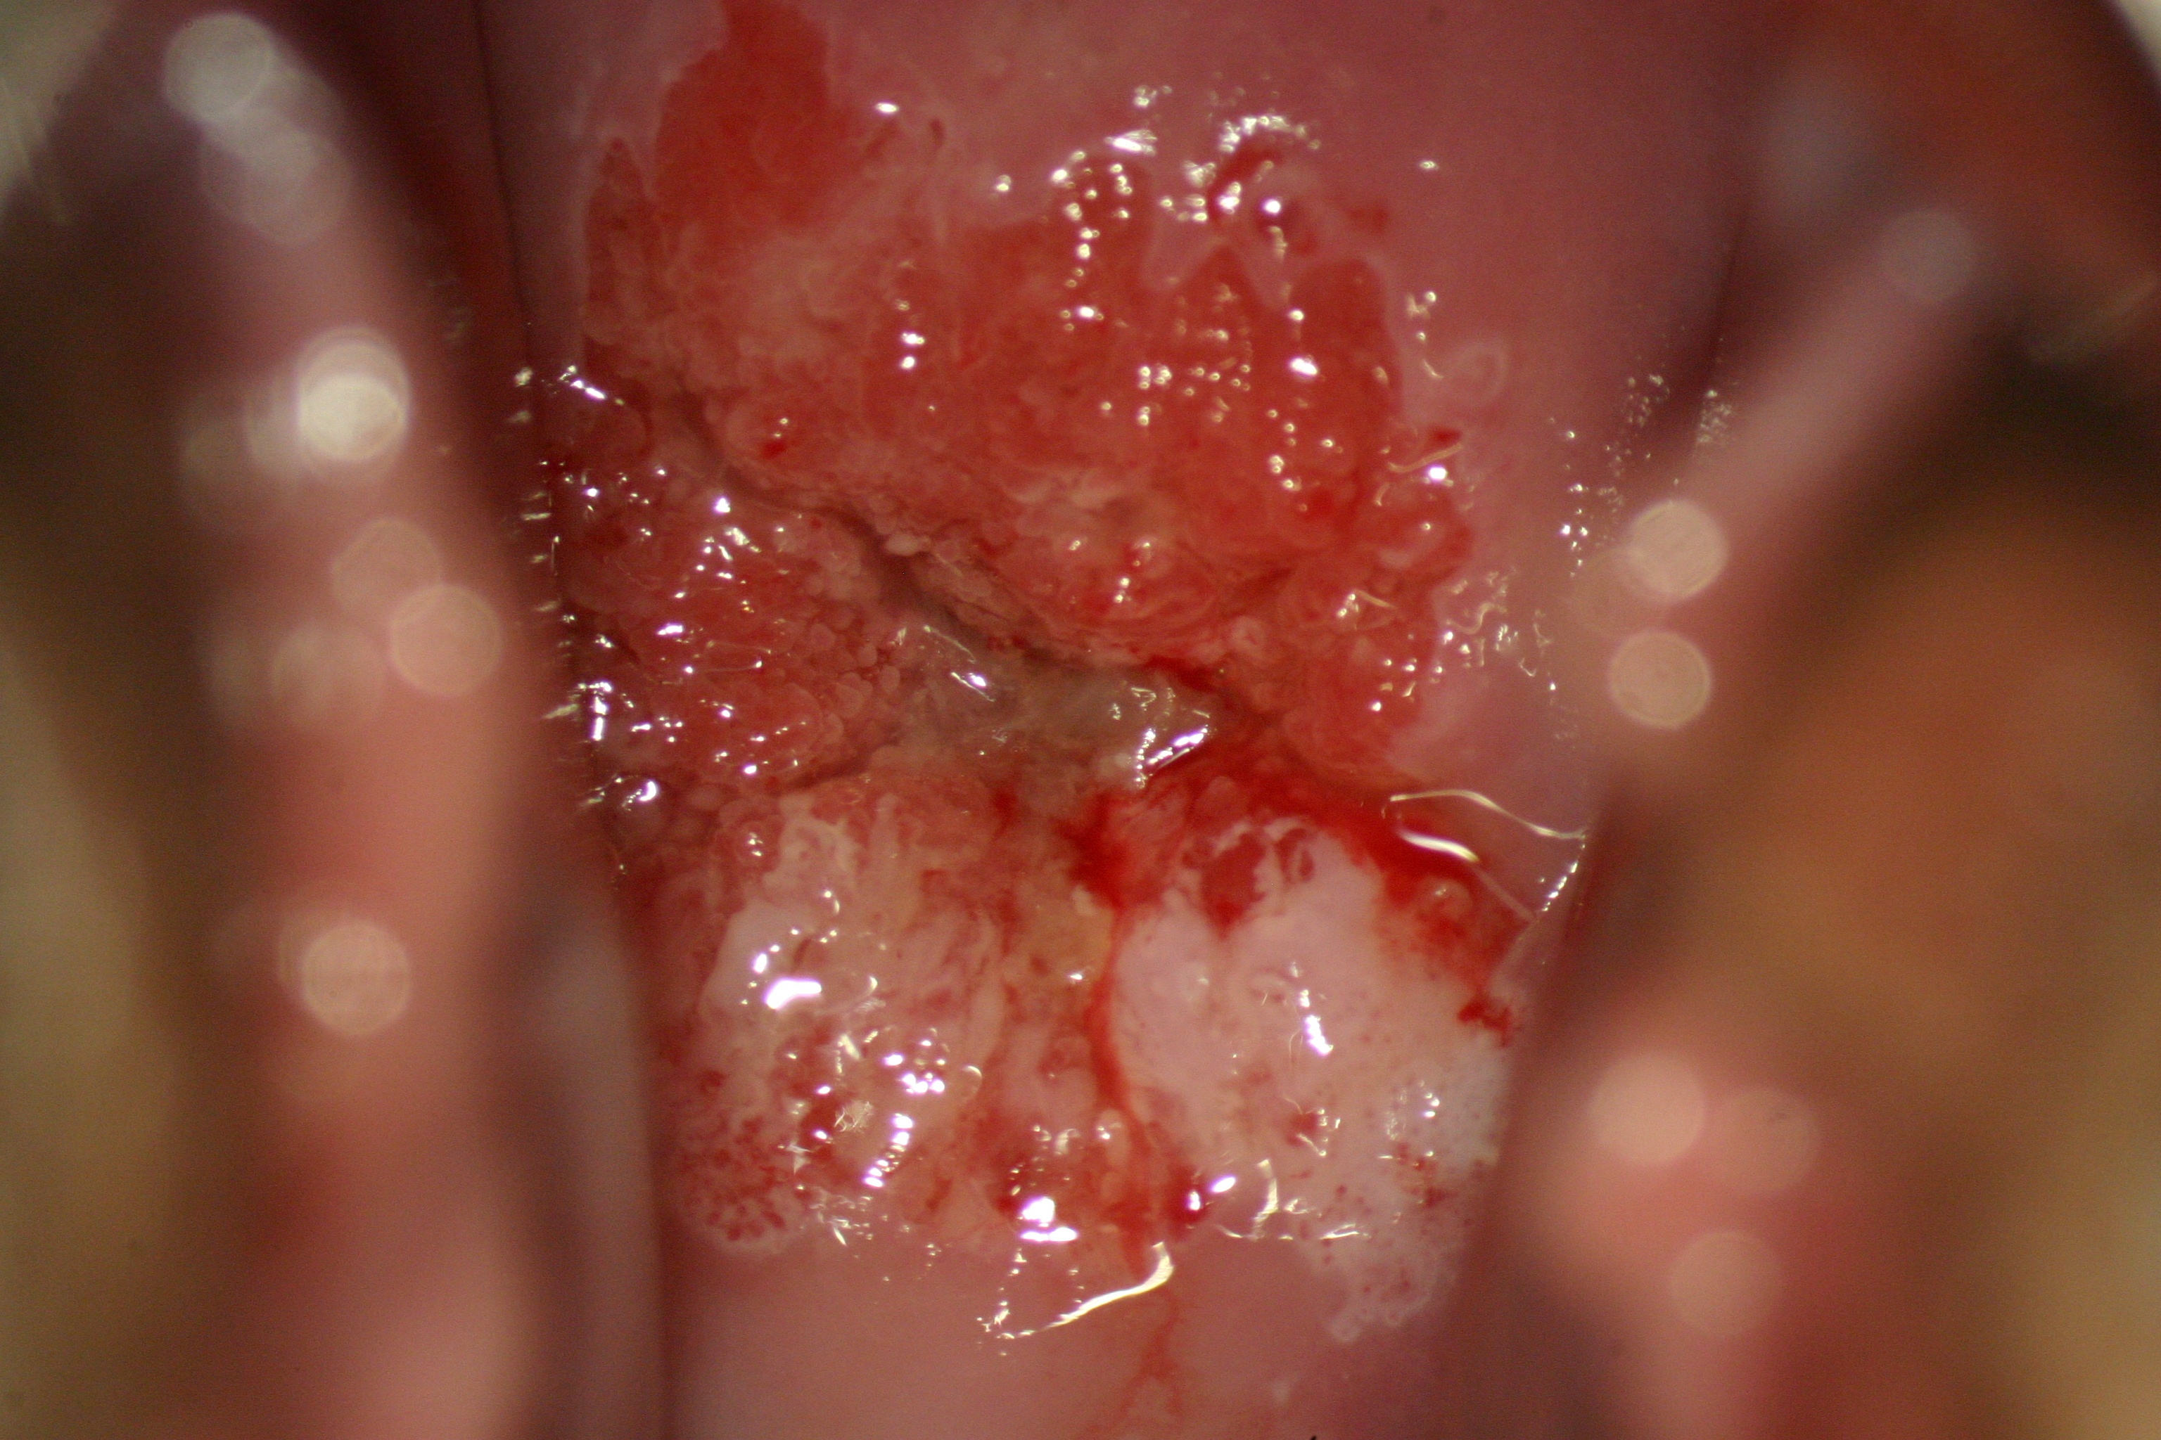
Case 1
24 yr old G0P0 with a HSIL pap

Slide 28
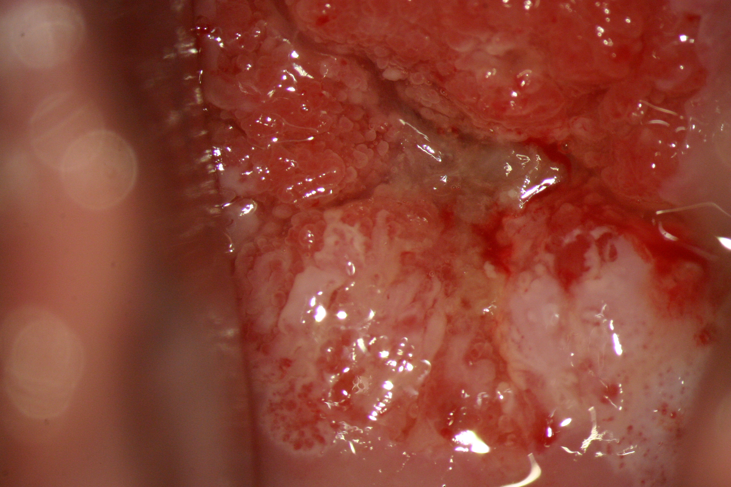
Case 1

Slide 29
Case 1
Adequate?
Normal? Abnormal?
TZ type?
Findings?
  Grade 1 vs. grade 2
Bx?
Diagnosis

Slide 30
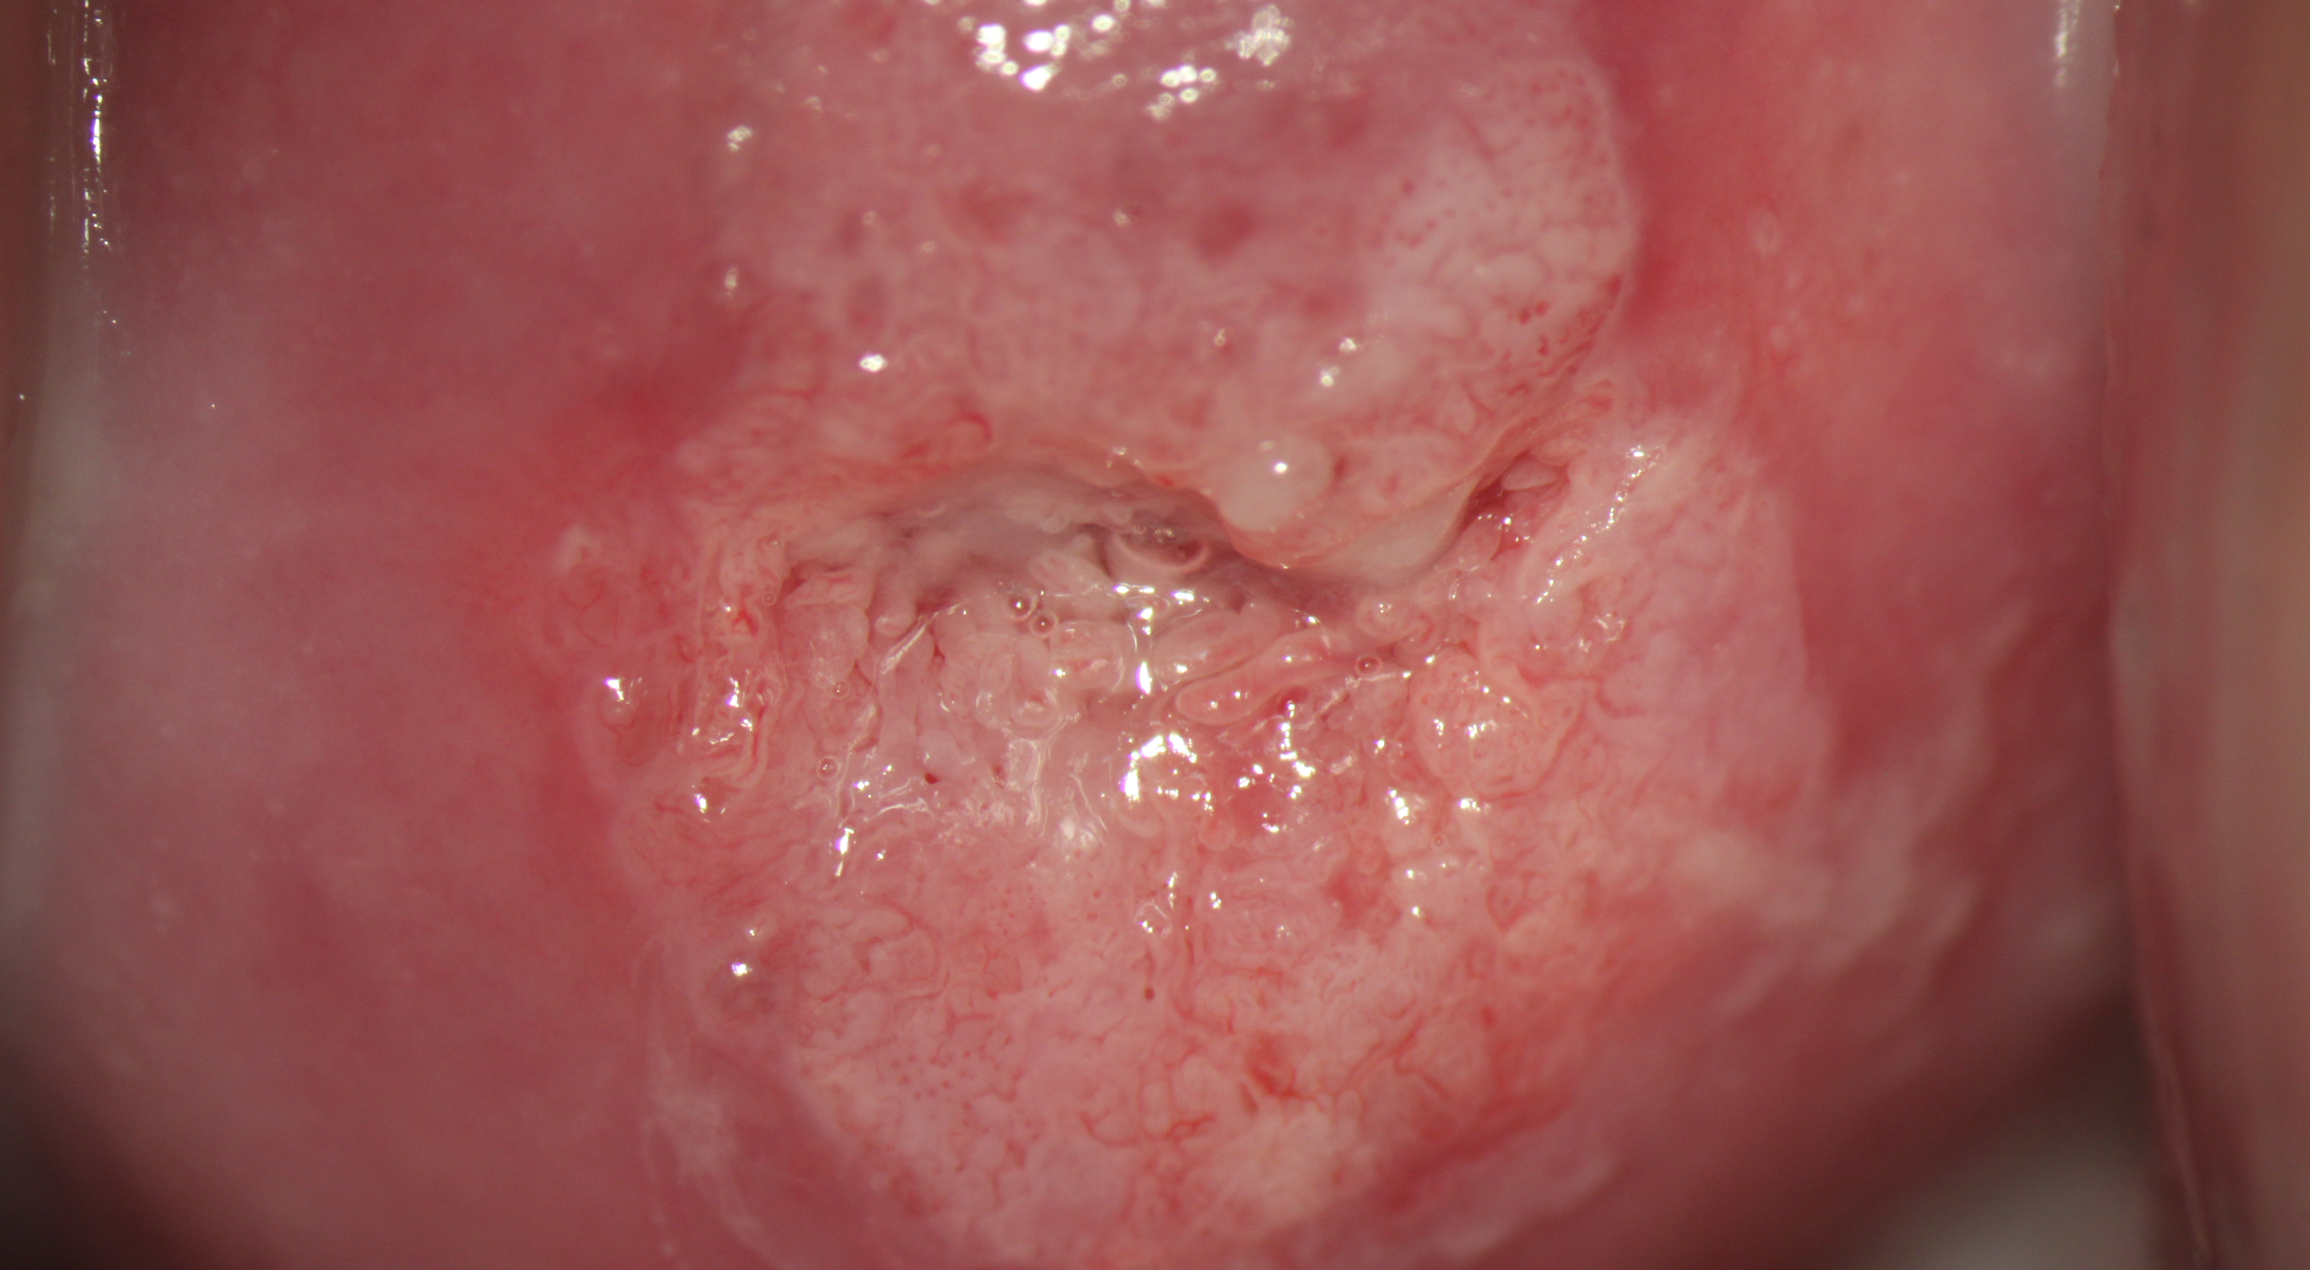
Case 2

Slide 31
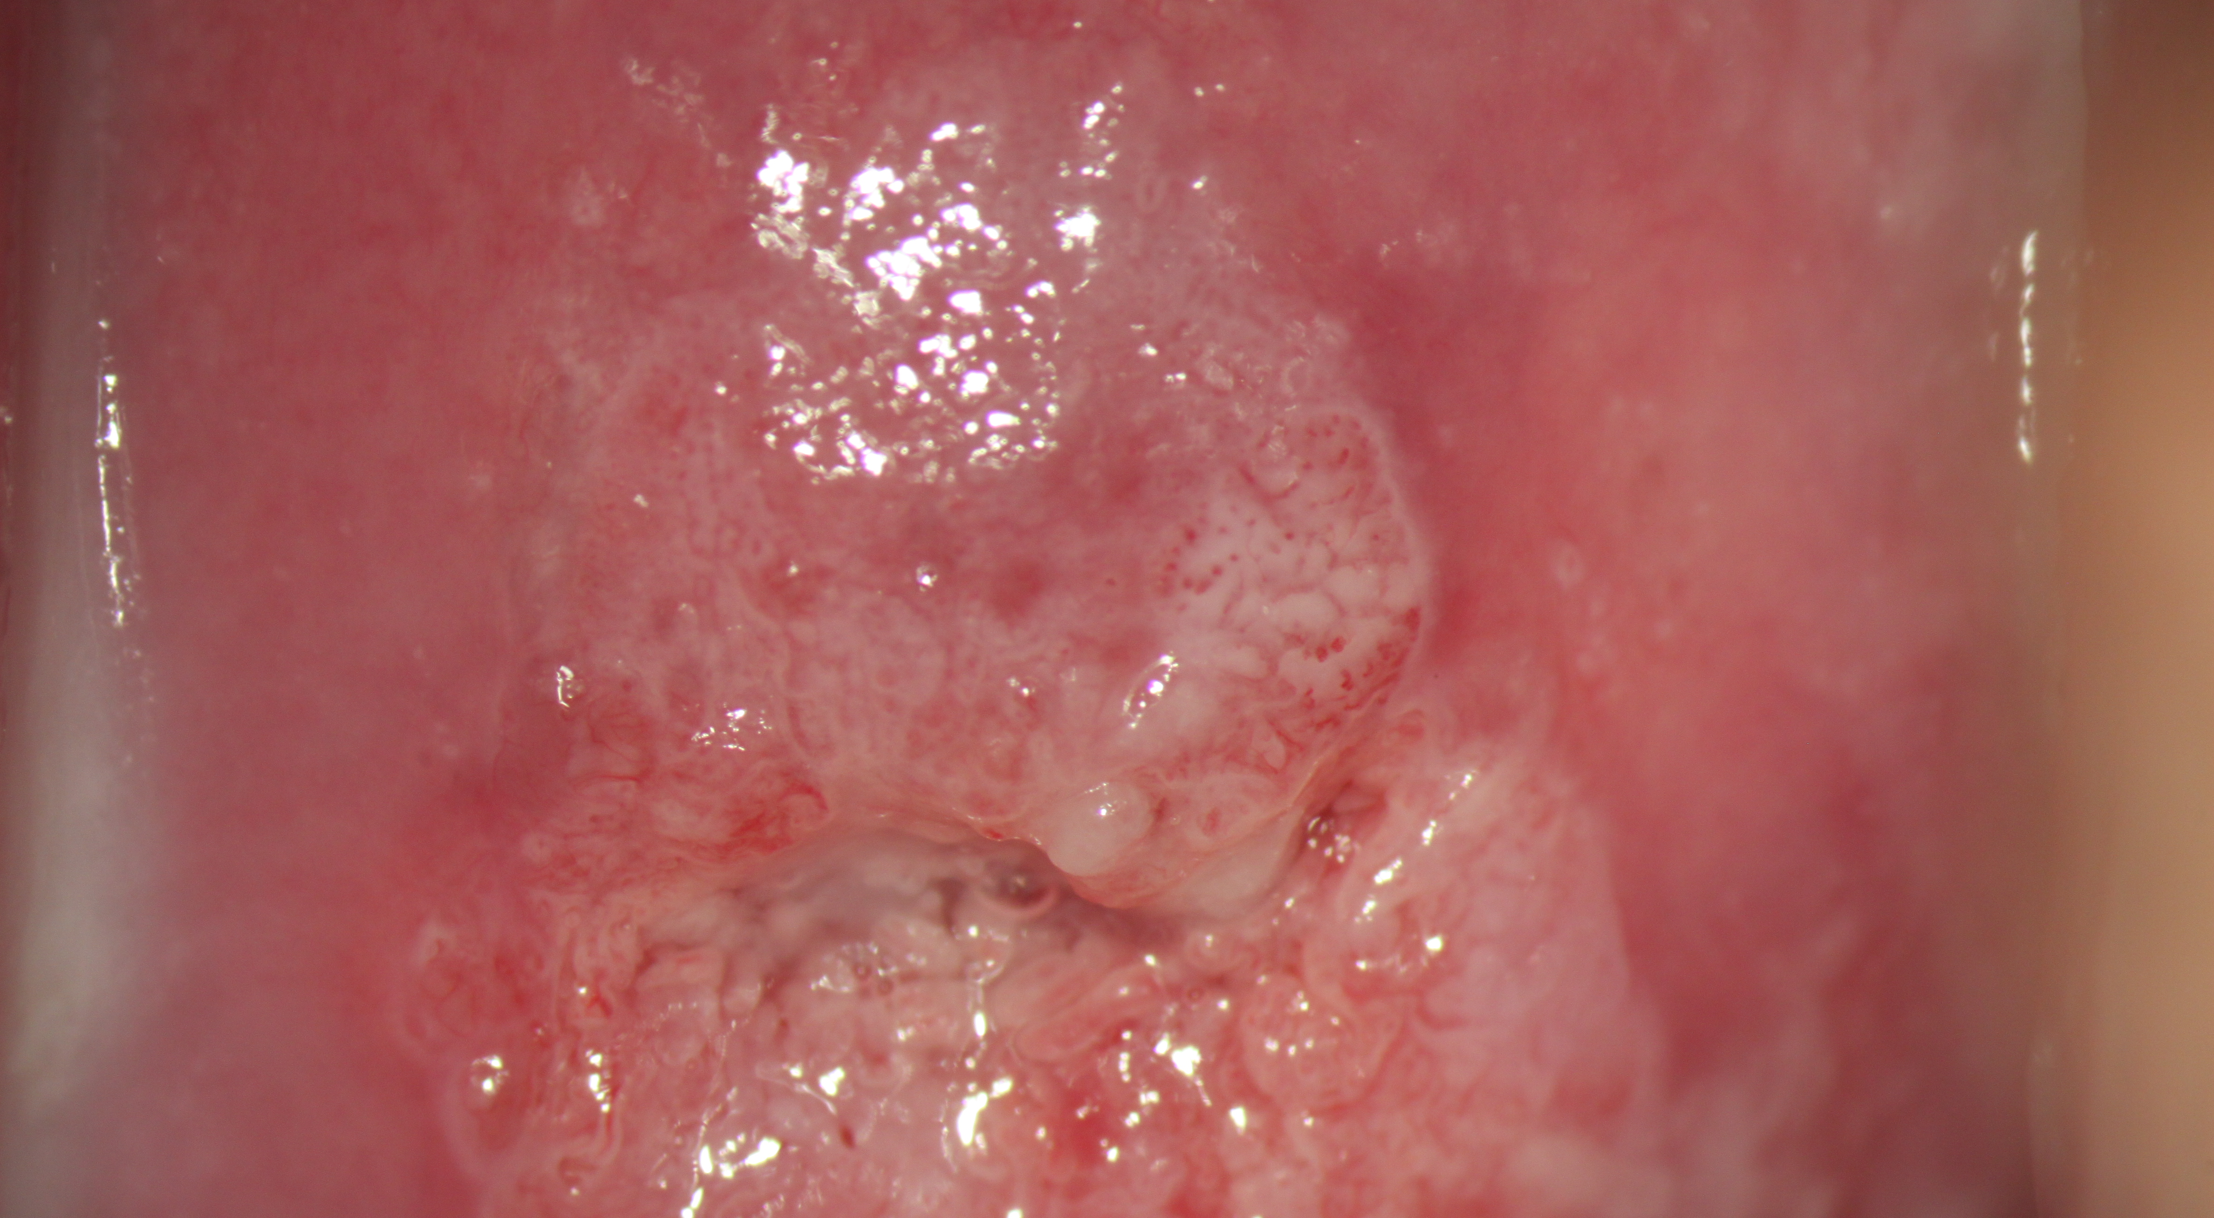
Case 2

Slide 32
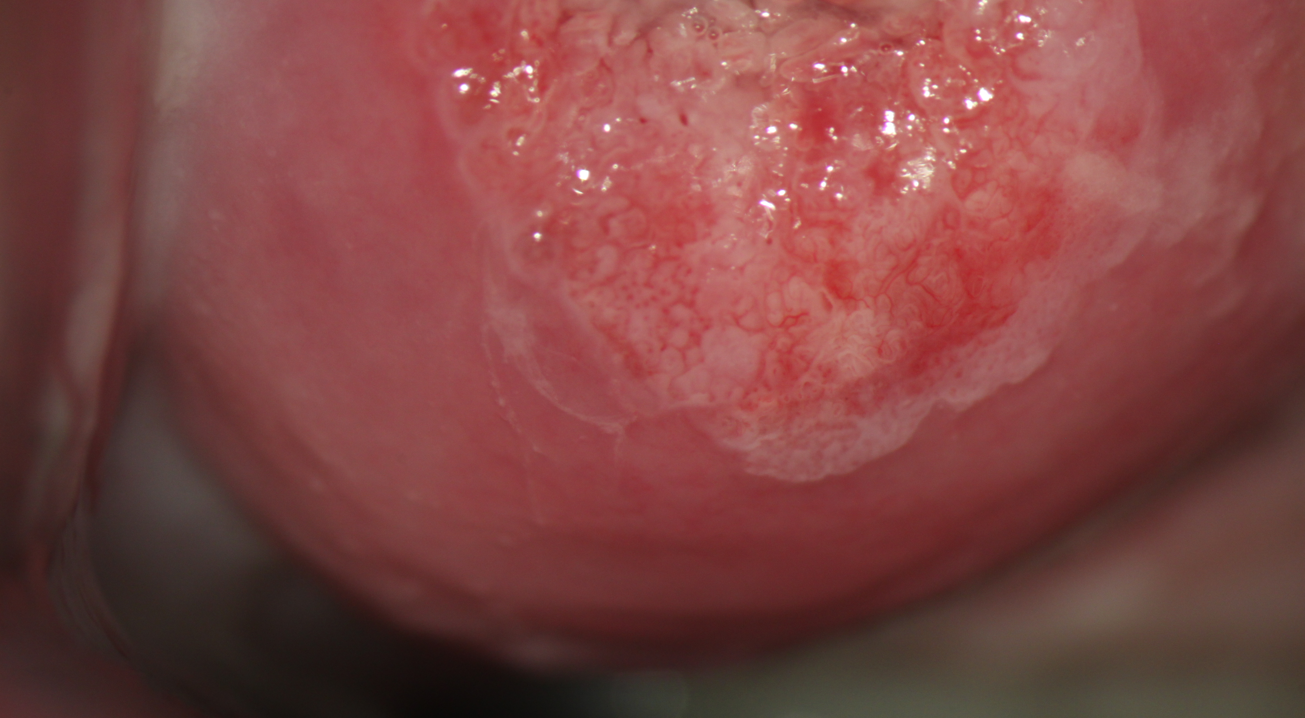
Case 2

Slide 33
Case 2
Adequate?
Normal? Abnormal?
TZ type?
Findings?
Bx?
Diagnosis

Slide 34
Conclusions
2011 terminology helps with standardisation
All colposcopists should be speaking the same language
The grade 1 vs. grade 2 features help with differentiating HSIL vs. LSIL

